Slide 1
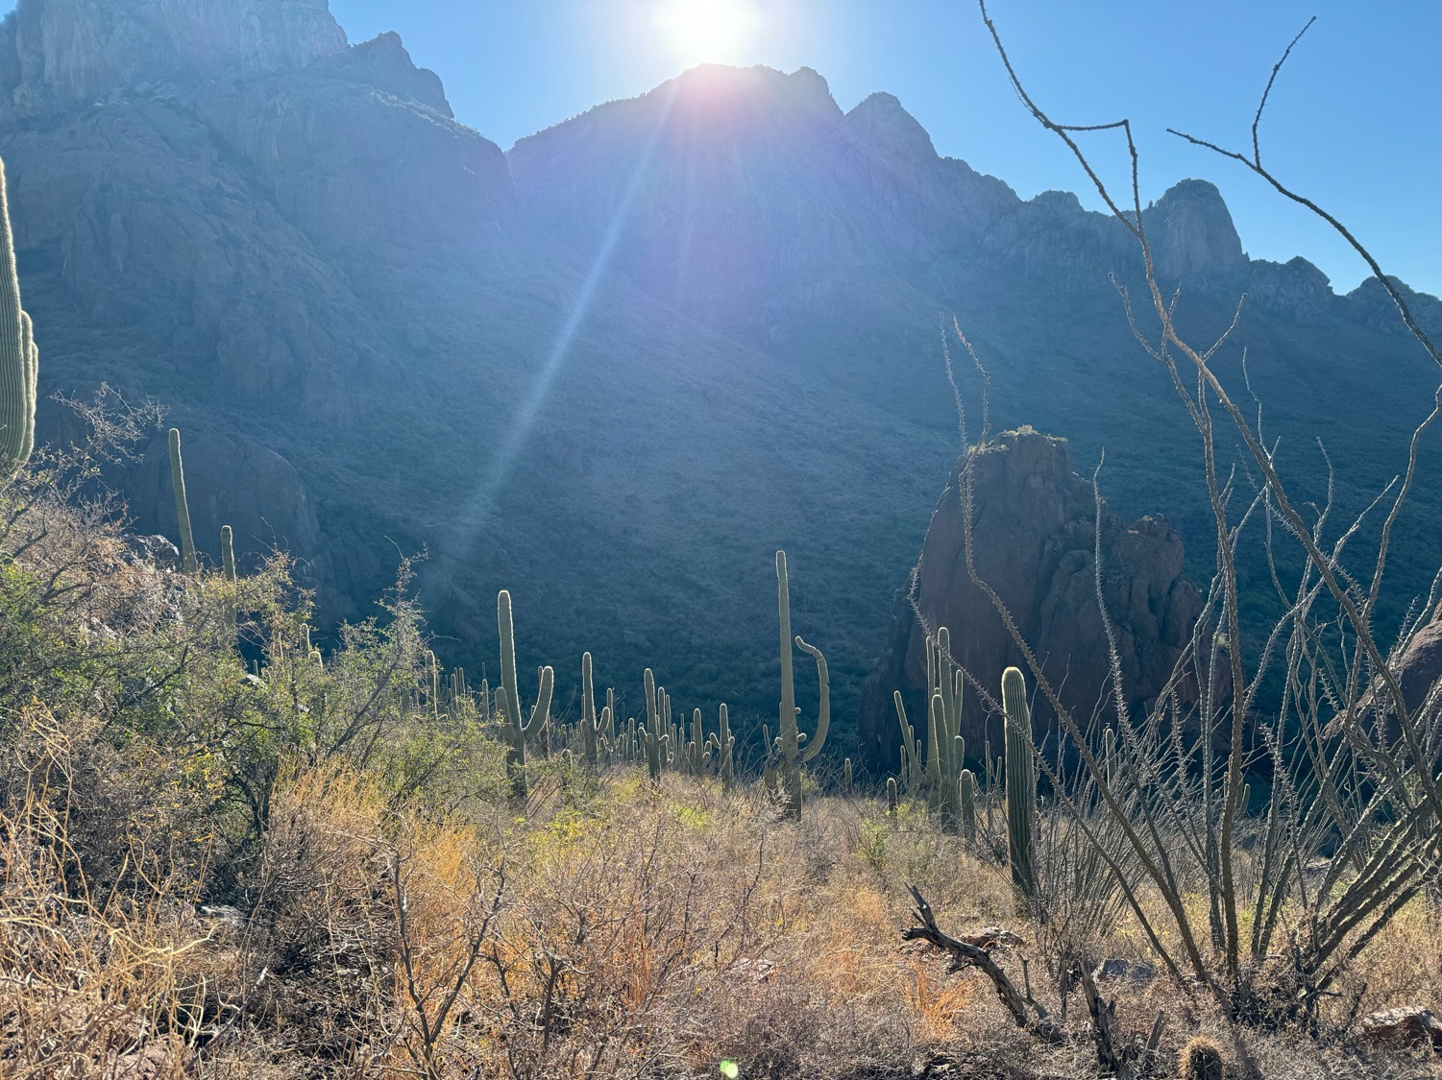
Basic Aspects and a Timeline
of the Saguaro Cactus
Robert A. Villa
11 December 2024

Slide 2
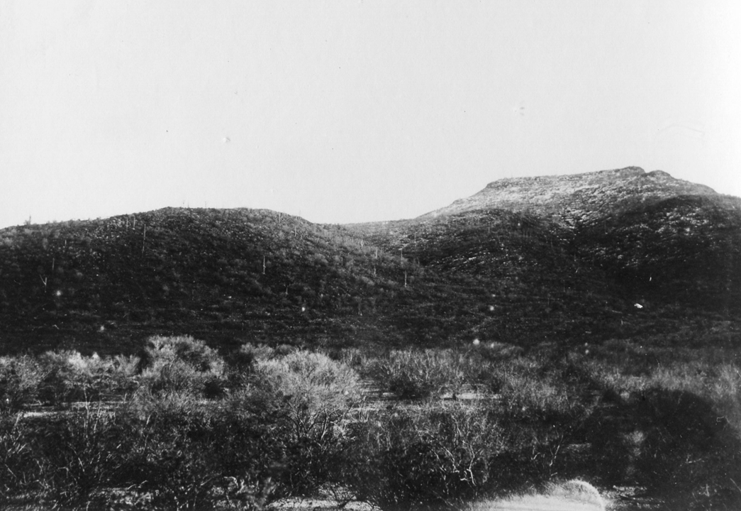
Chemagagi Du’ag
(Tohono O’odham: Horned Lizard Mountain)

Slide 3
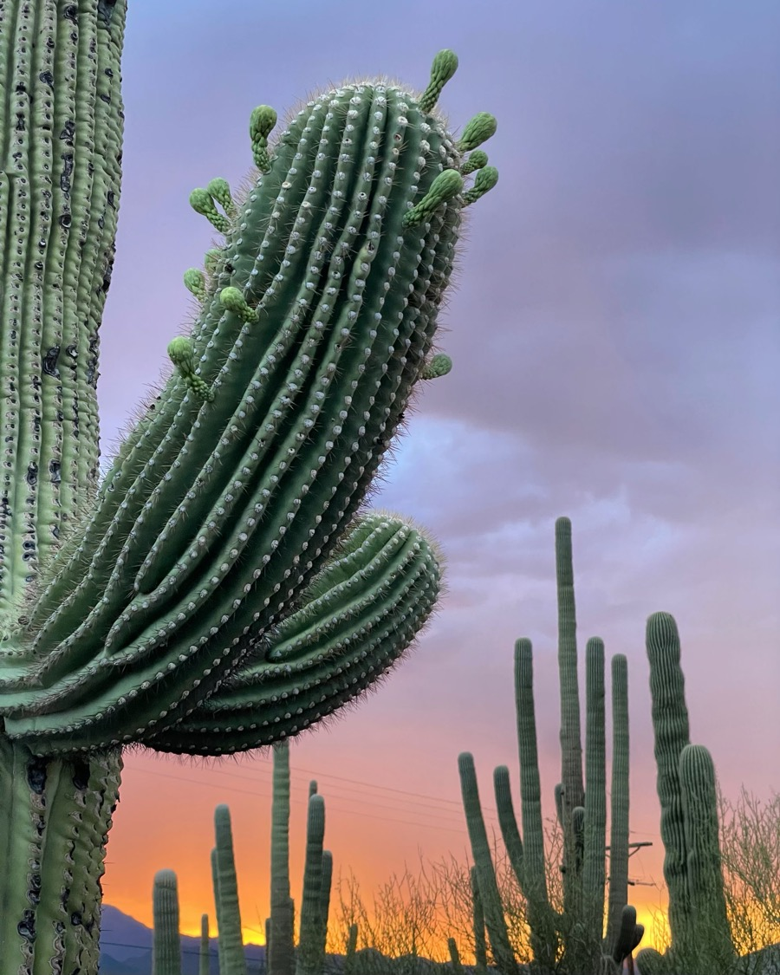
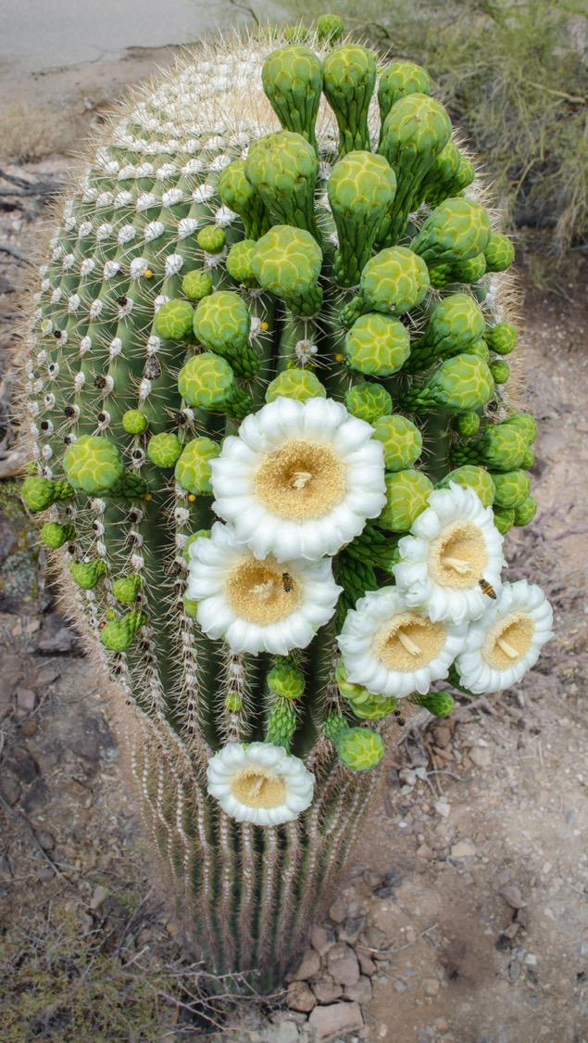
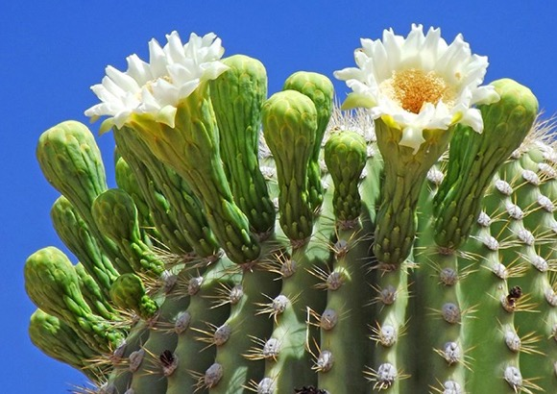
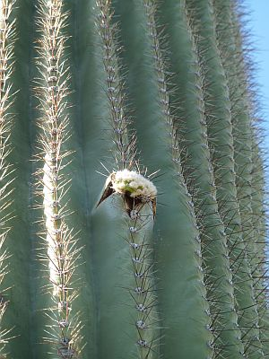
Hasañ
Hiosig
Ihbdag
Mamhadag
Pollen = Chu’i
Spine = Ho’i

Slide 4
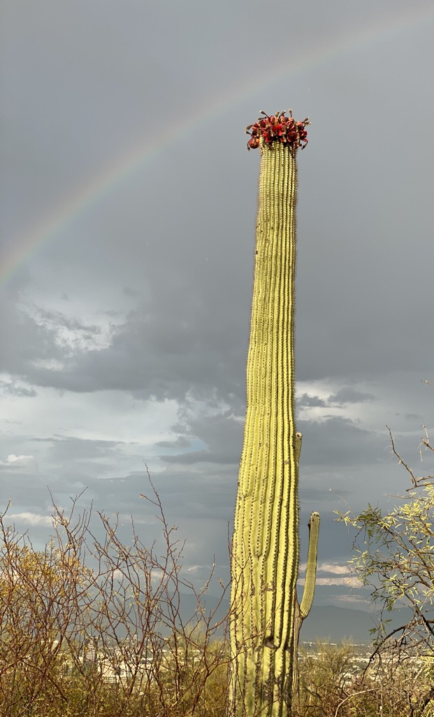
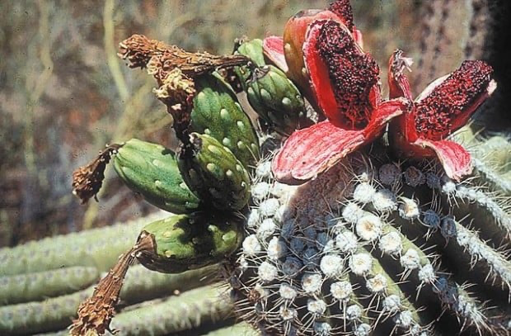
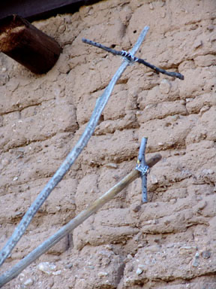
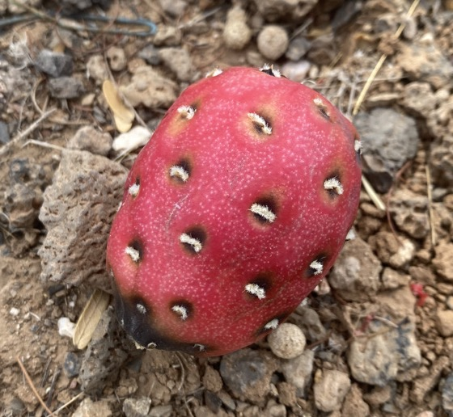
Ju-ñ
Hiosig gakidag
Eldag
Do’idag
Kukuipad
Bahidag

Slide 5
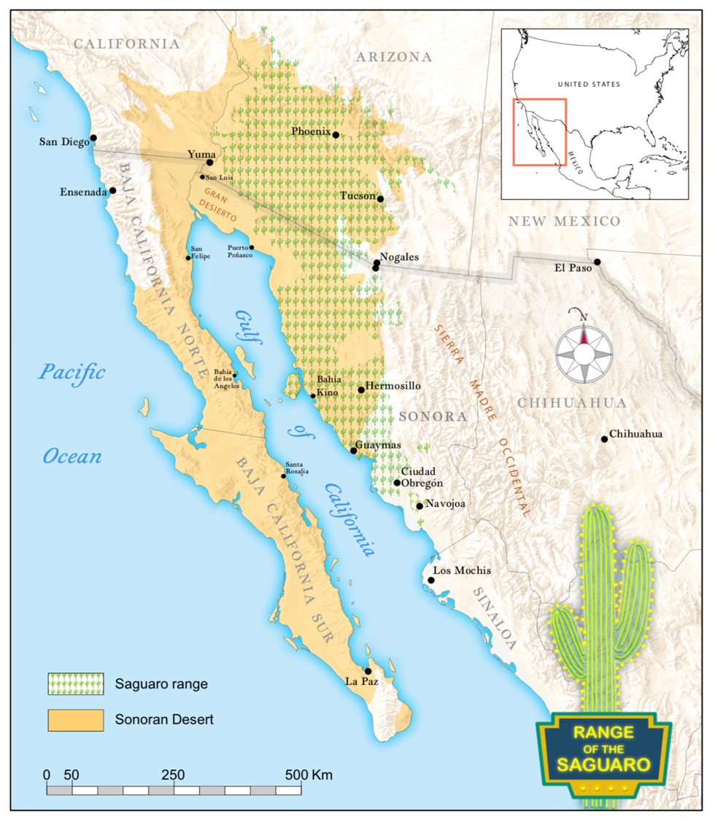
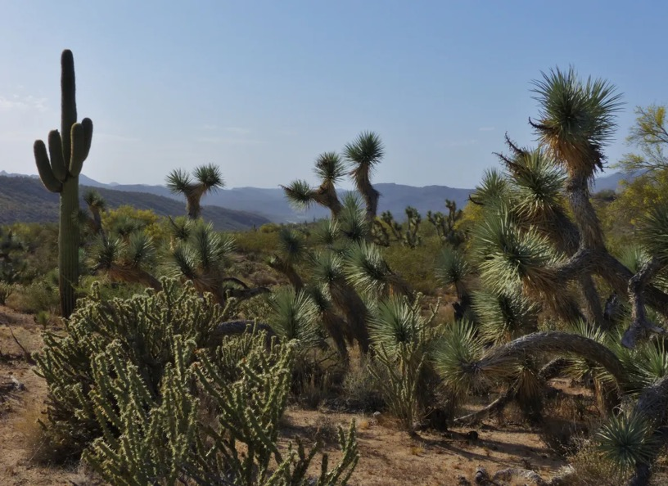
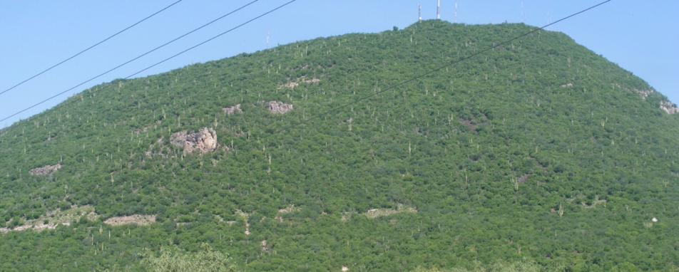

Slide 6
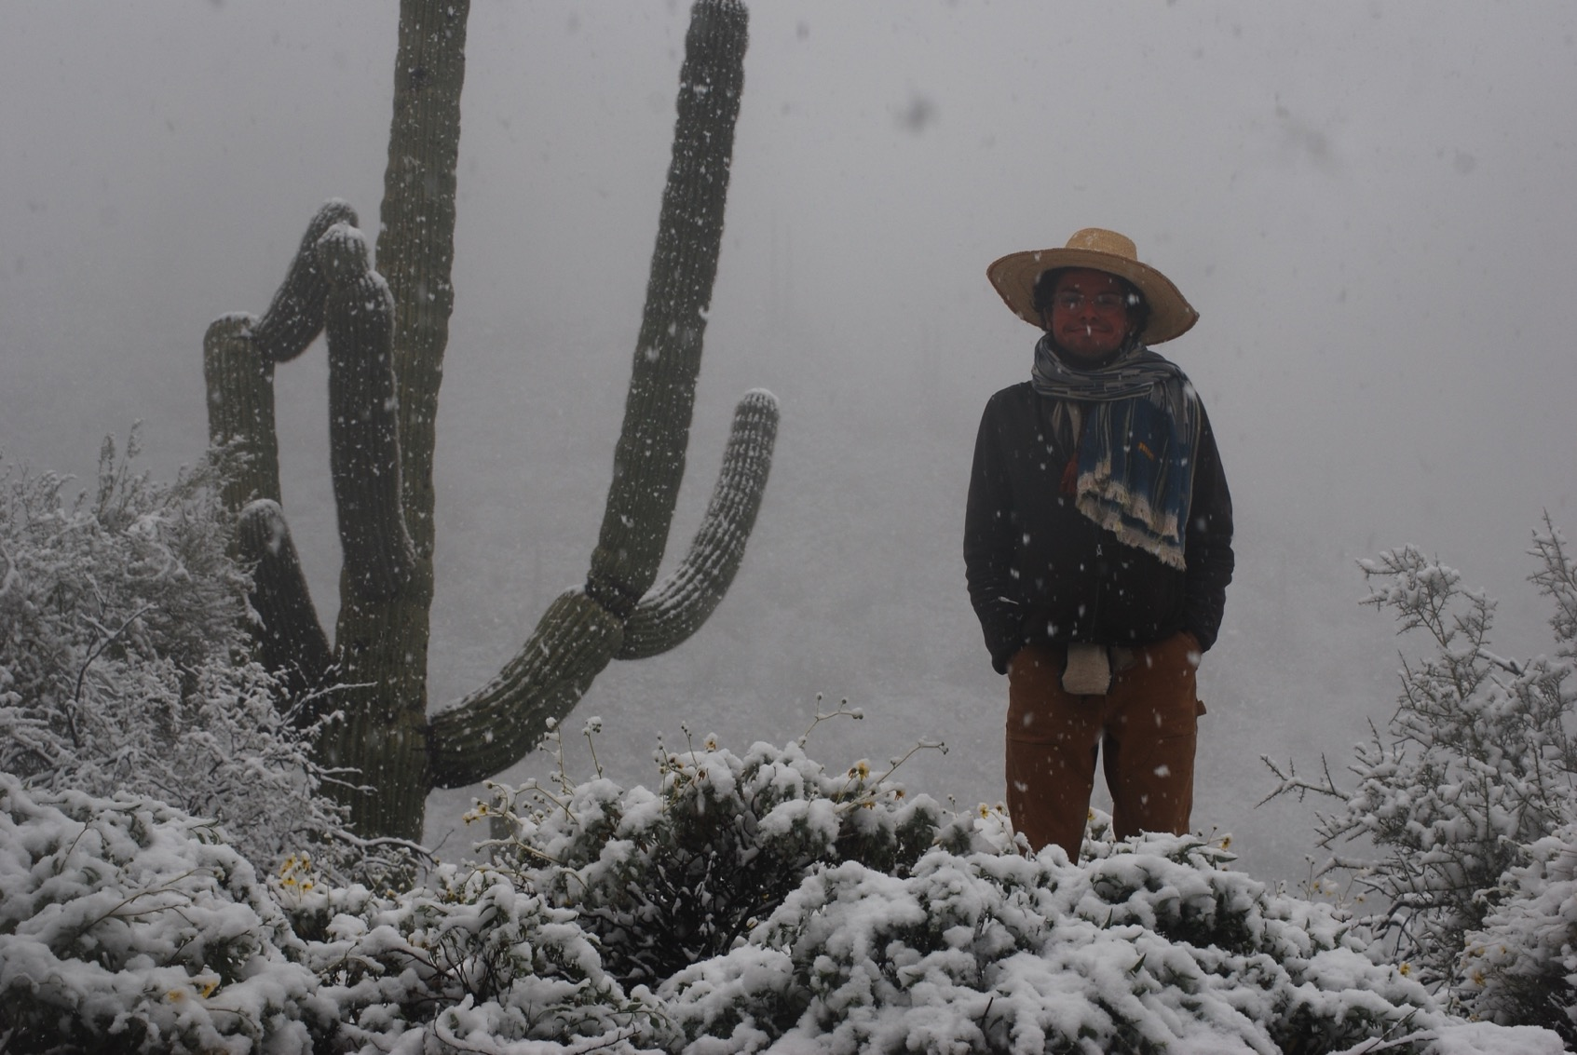
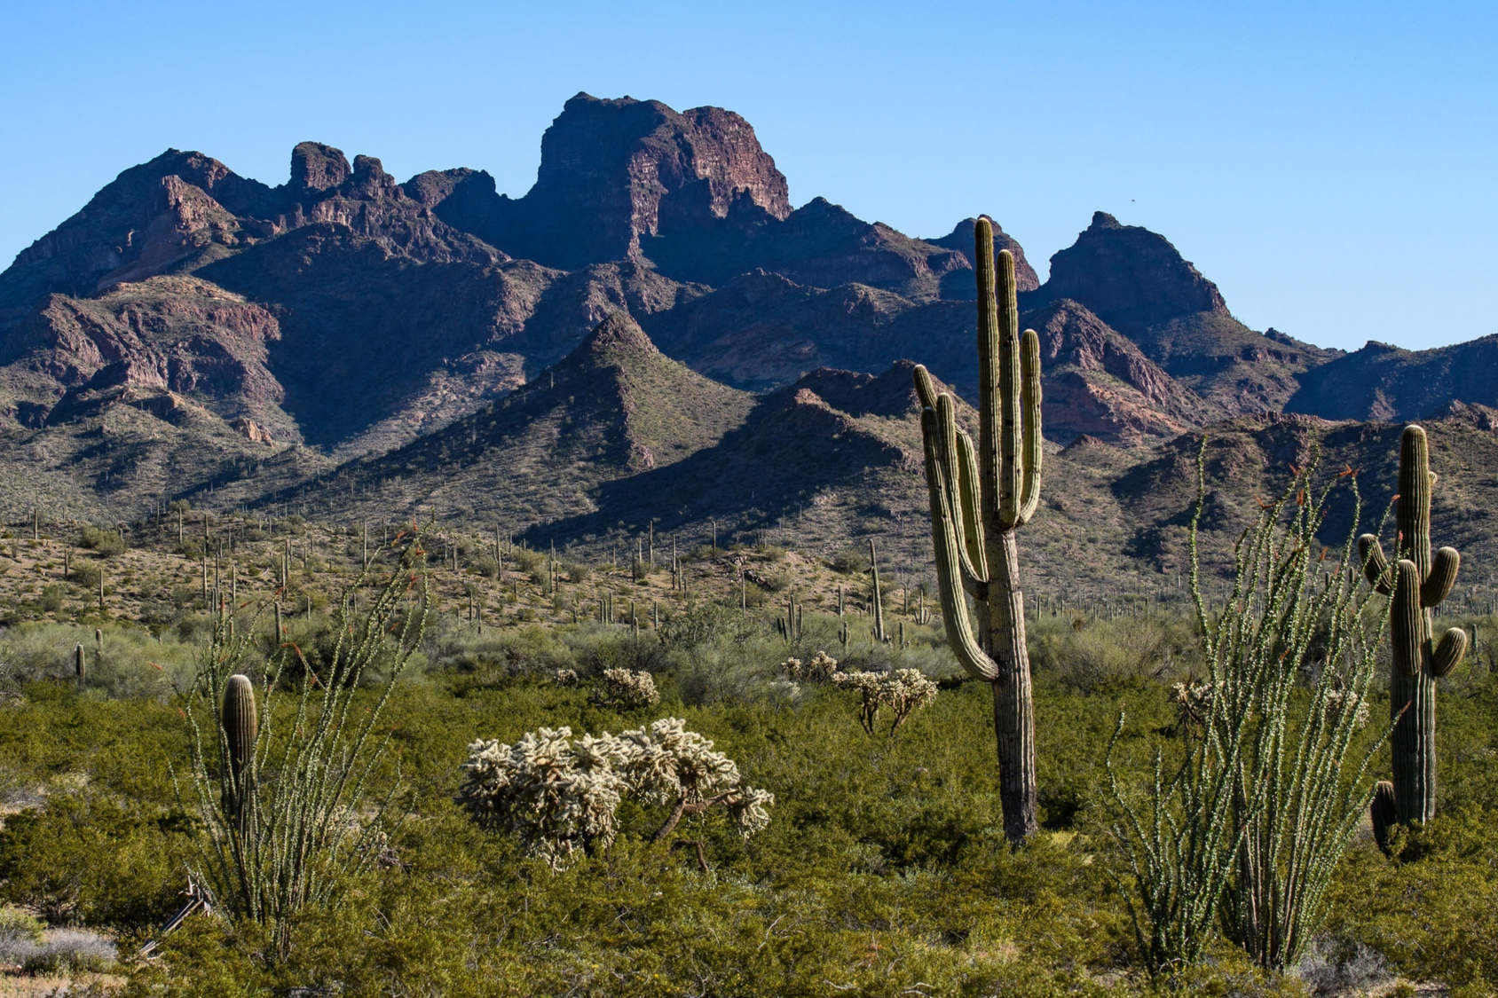
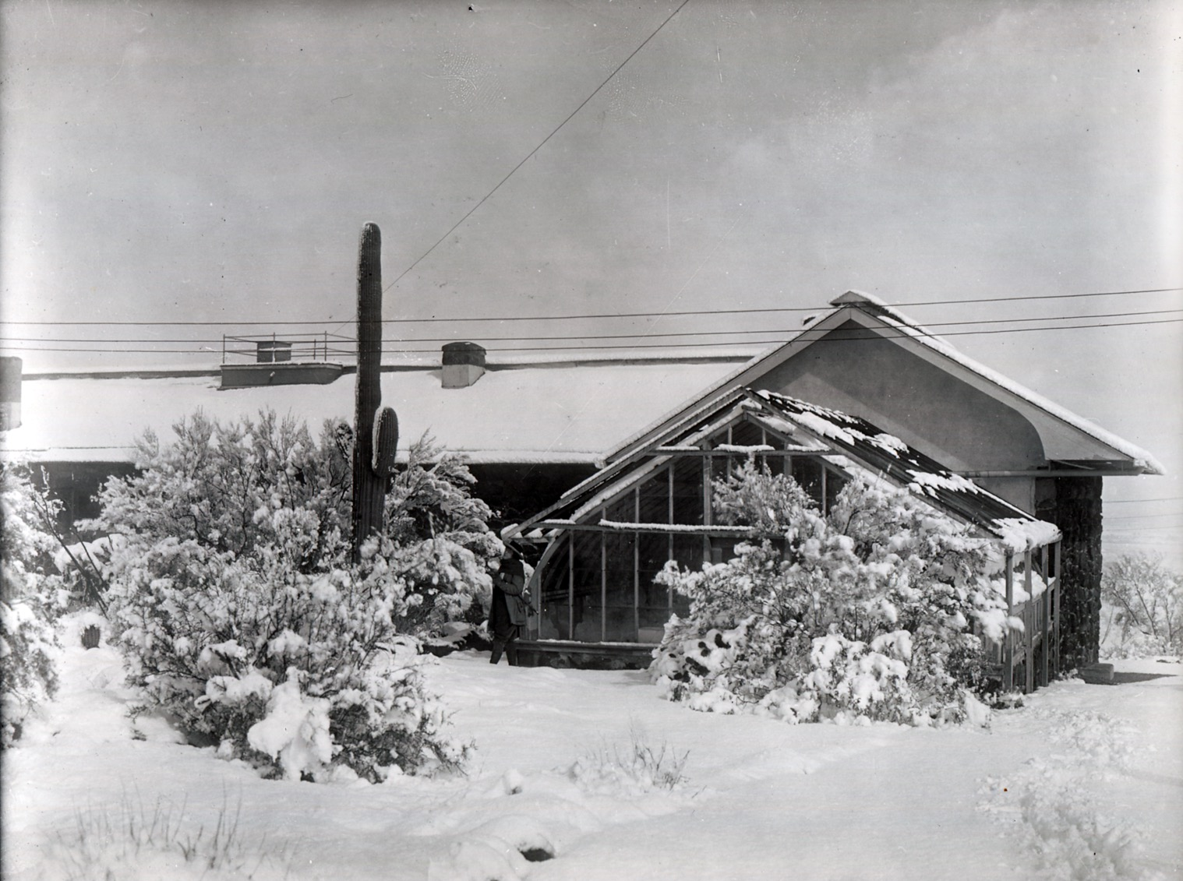
New York Times | Michael Benanav

Slide 7
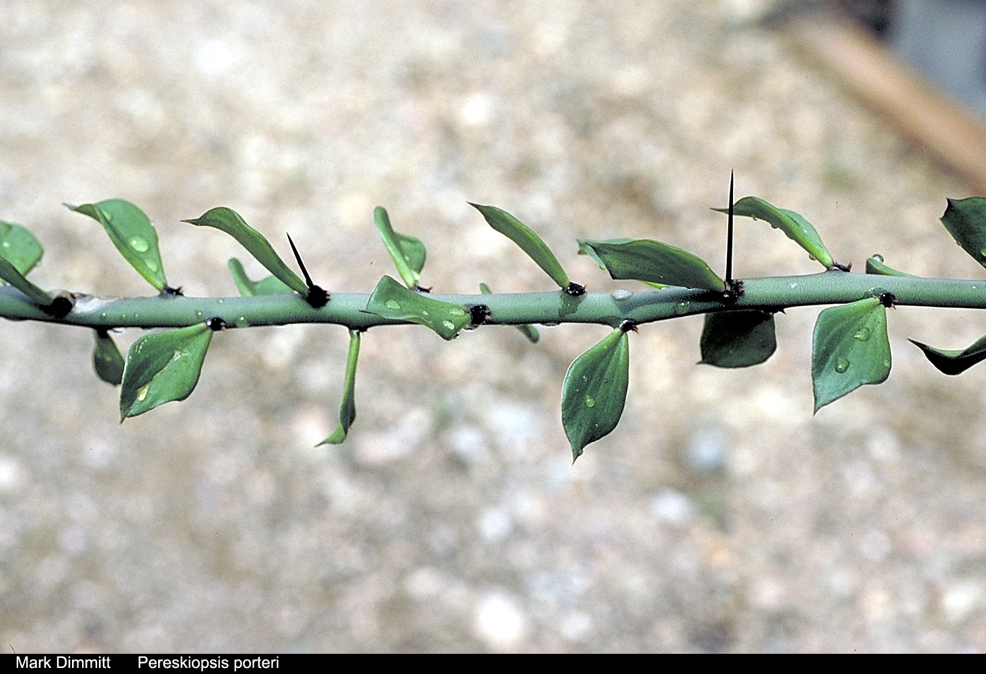

Slide 8
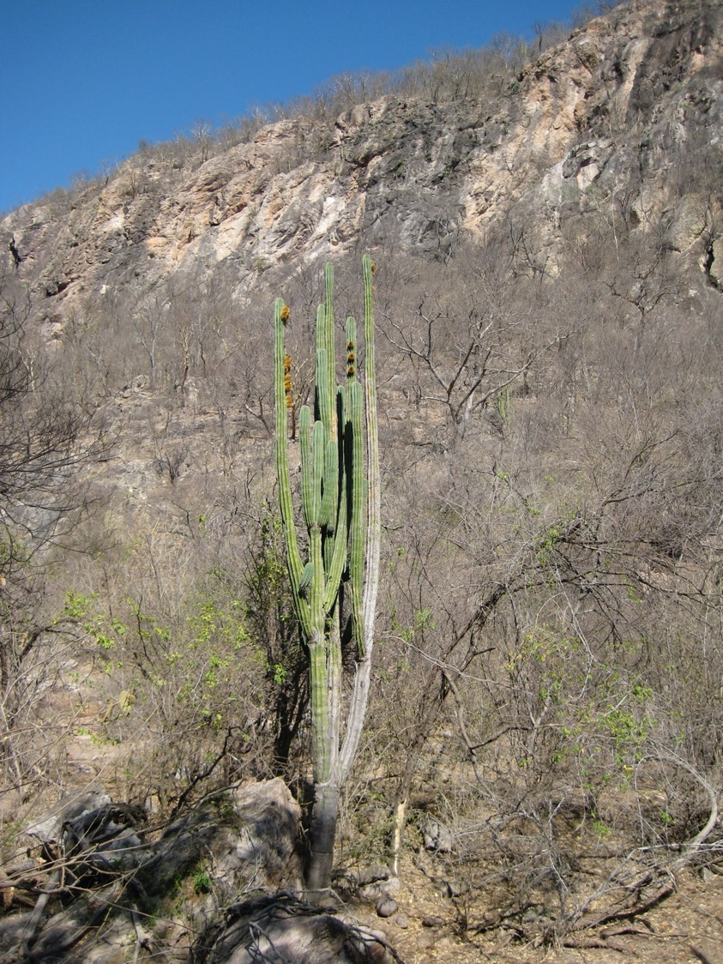

Slide 9
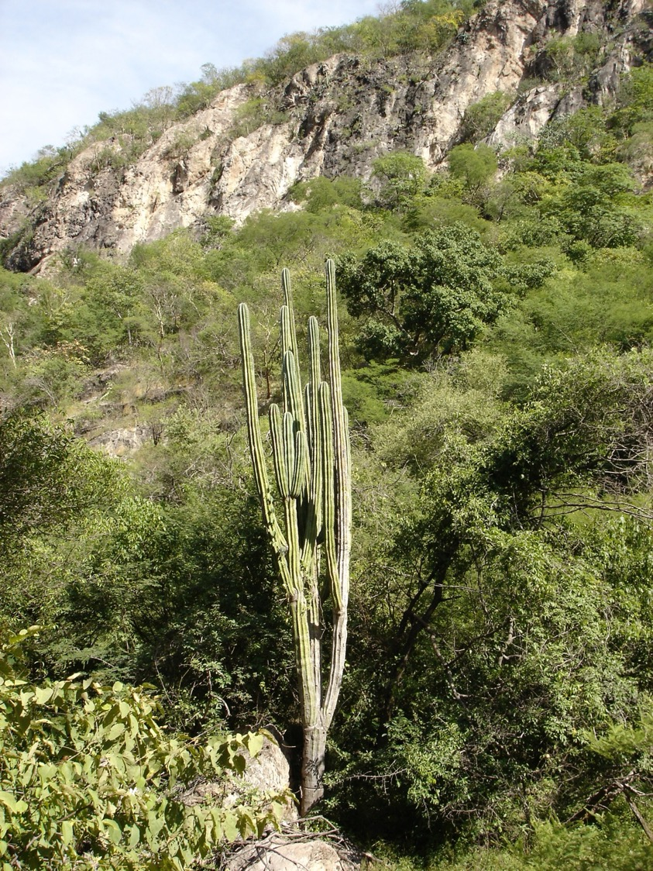

Slide 10
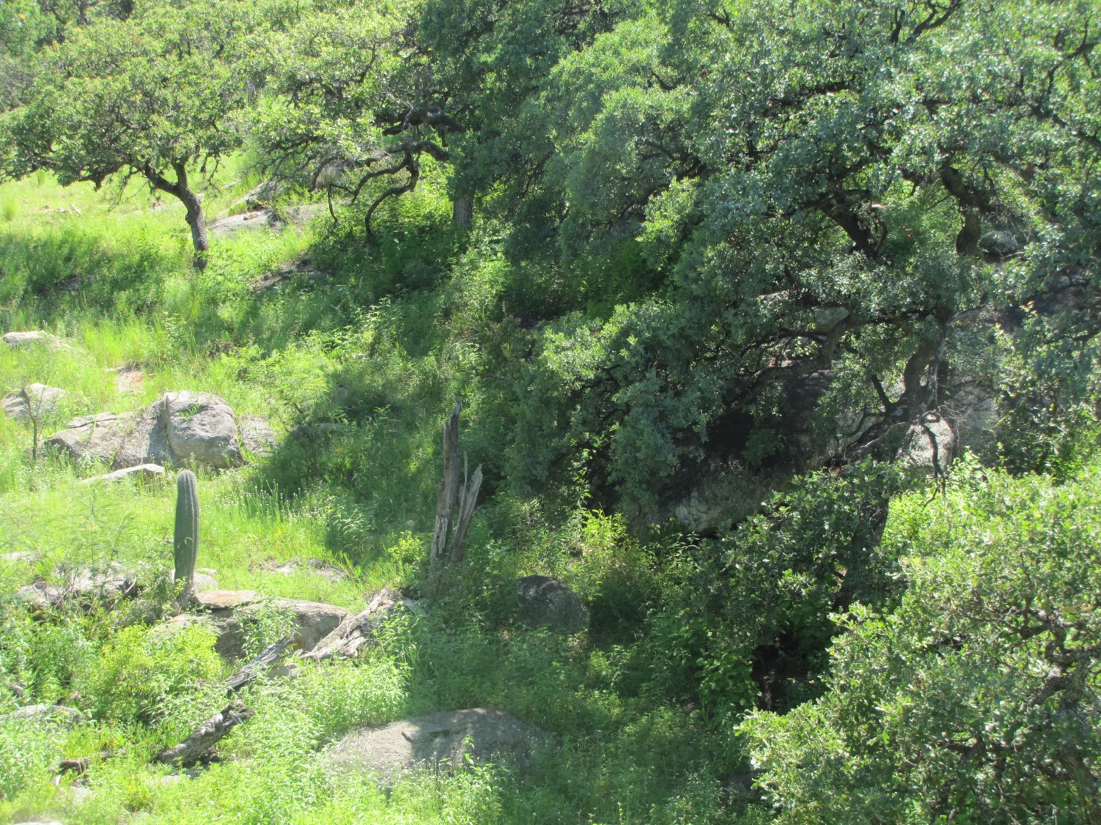

Slide 11
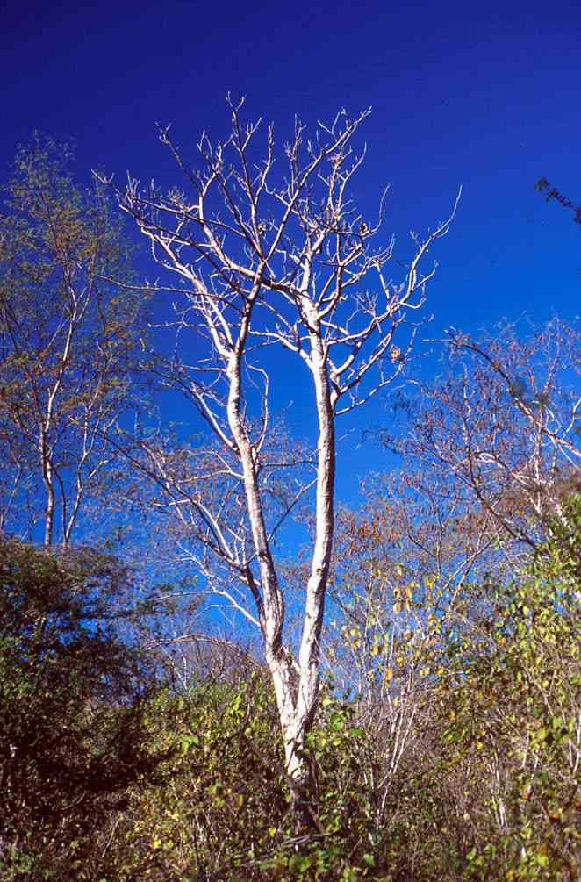
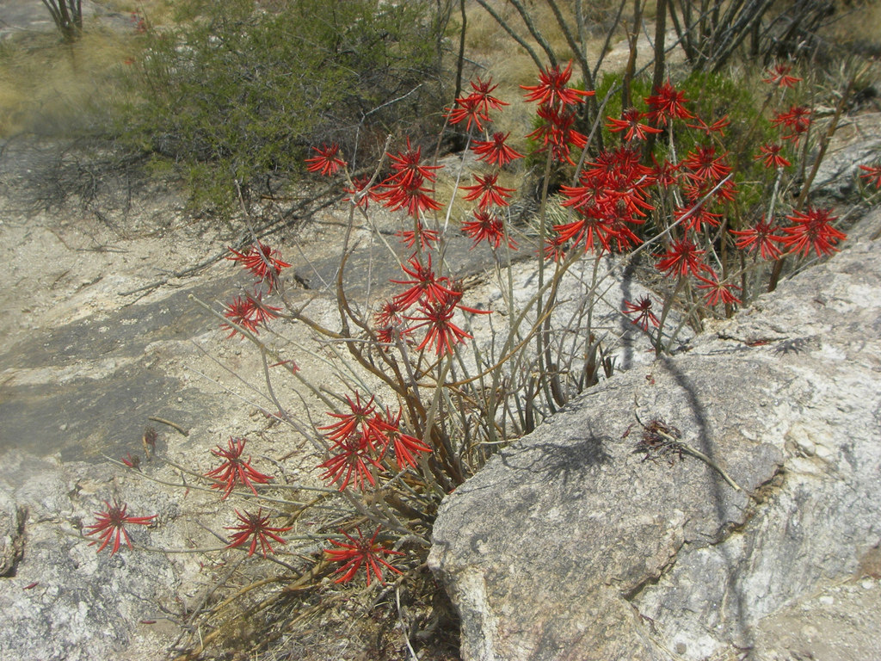

Slide 12
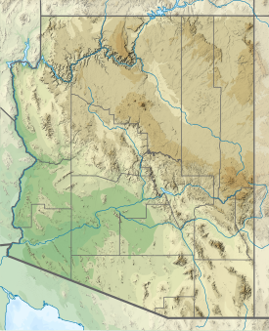
Ca. 1540 – Saguaro is first witnessed by Europeans on the Coronado Expedition and named “Saguaro”, a Cáhitan word.
1626 – First printed record of Saguaro by Salmerón on the Oñate expedition of 1604-1605: October 1605: ”They arrived at … San Andrés [Bill Williams River]. ... There were many pitahayas and different kinds of trees.”

Slide 13
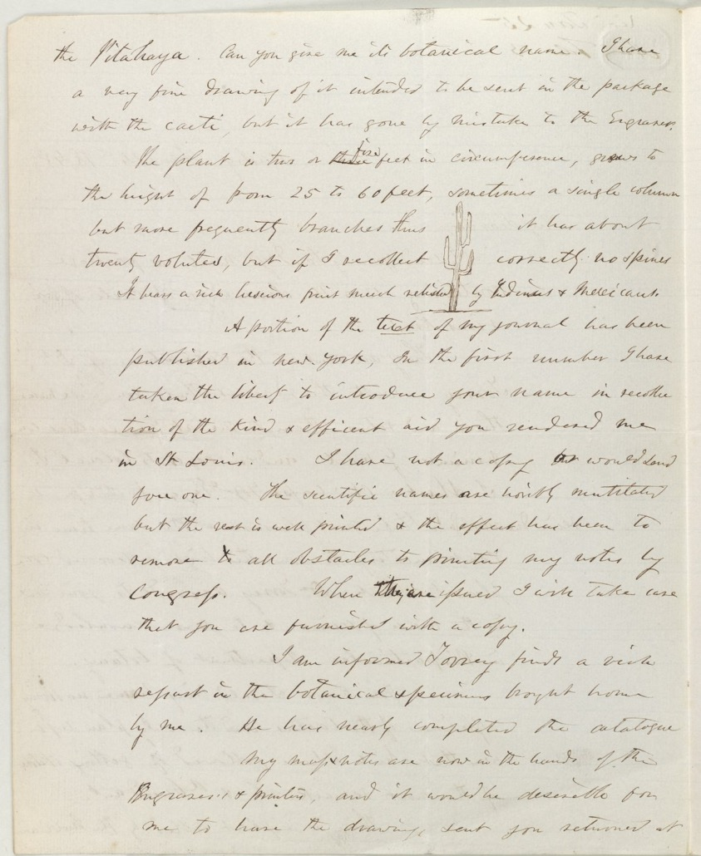
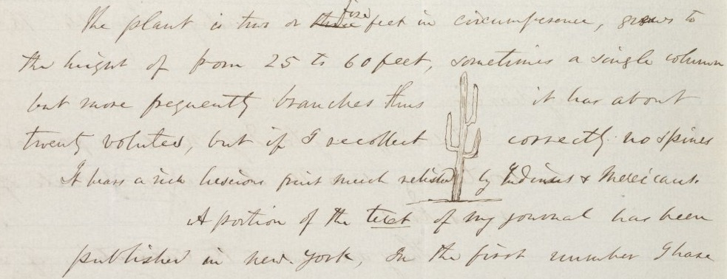
1848 – Letter from Engelmann to Emory

Slide 14
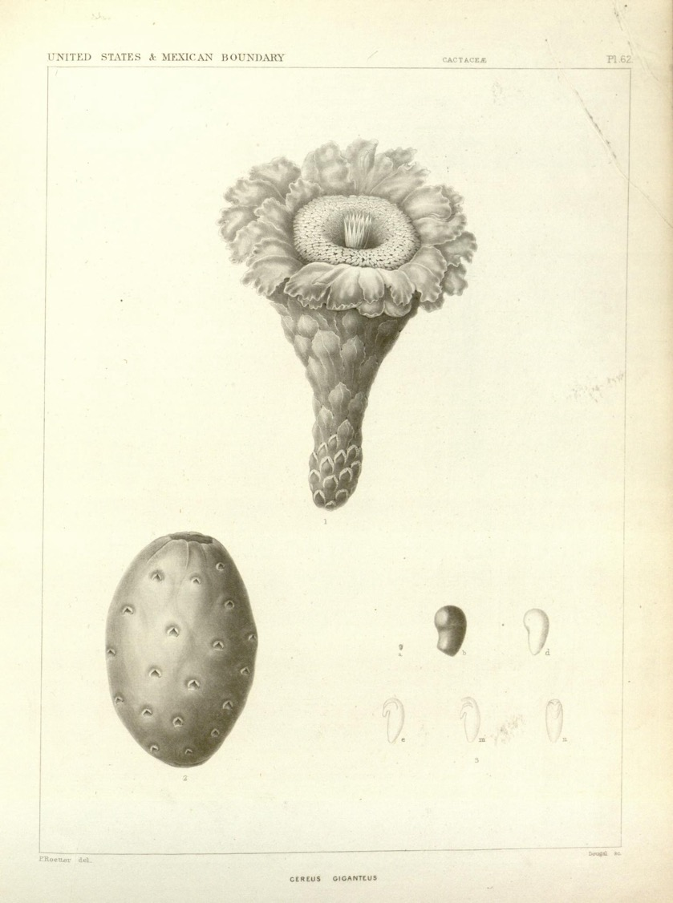
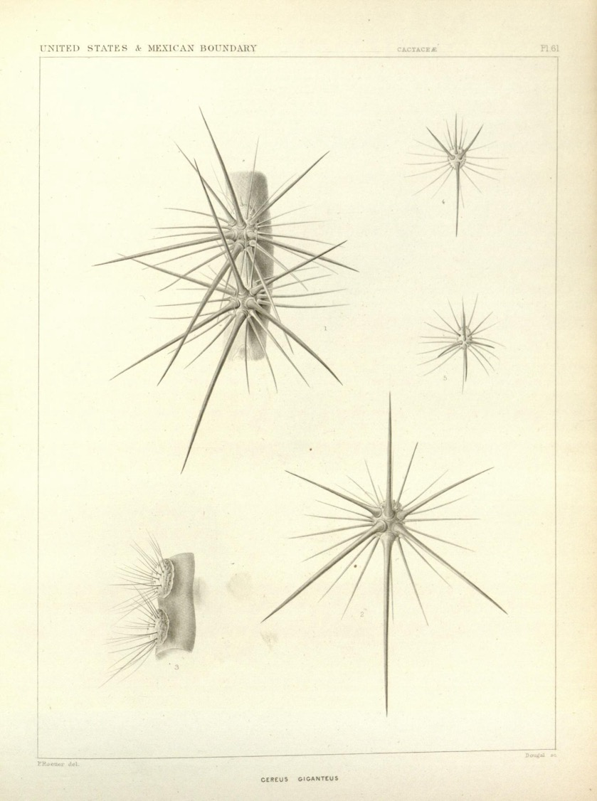
1859 – First academic botanical illustration of the Saguaro (Paulus Roetter, in Engelmann, in Emory 1859 Cactaceae of the Boundary [v2.p1])

Slide 15
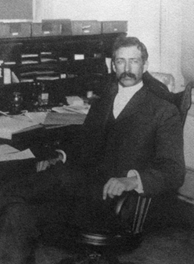
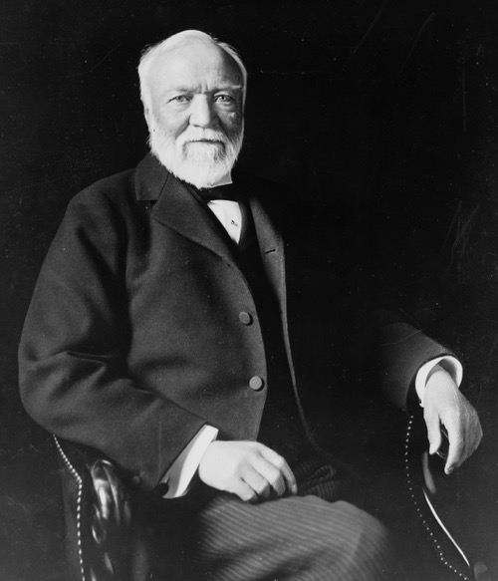
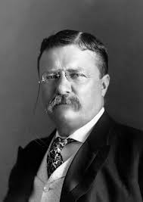
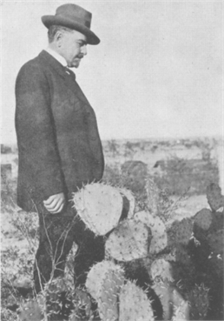
Frederick V. Coville
Andrew Carnegie
Theodore Roosevelt
Daniel T. MacDougal

Slide 16
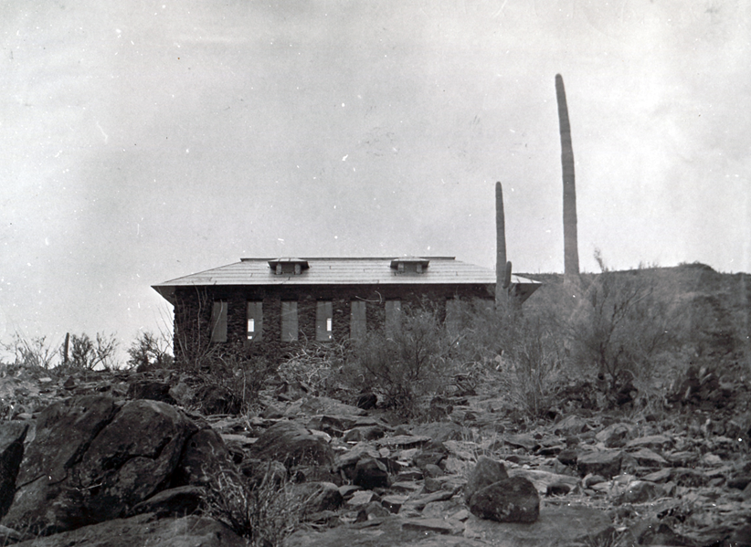
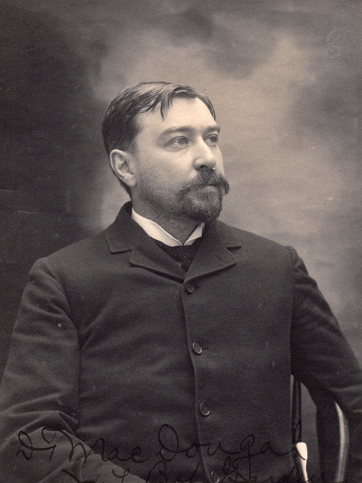
Desert Botanical Laboratory
Daniel T. MacDougal
1903–1928
October 7, 1903

Slide 17
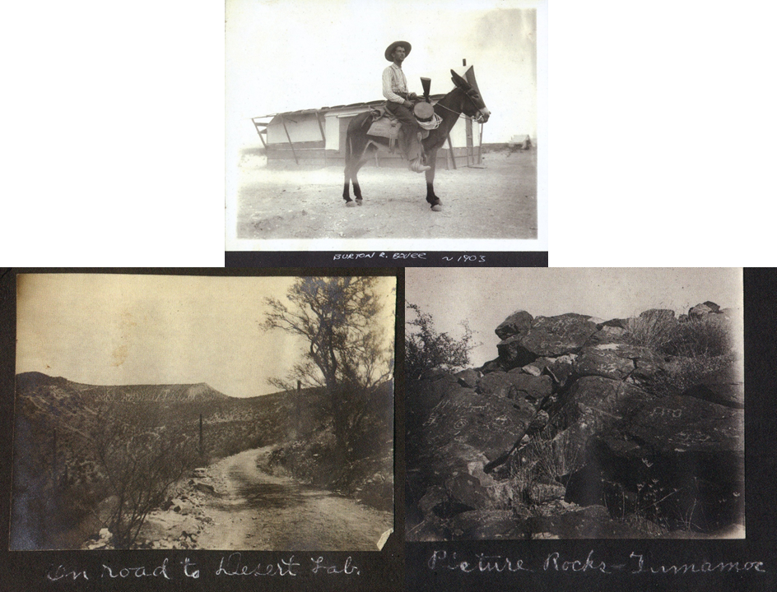

Slide 18
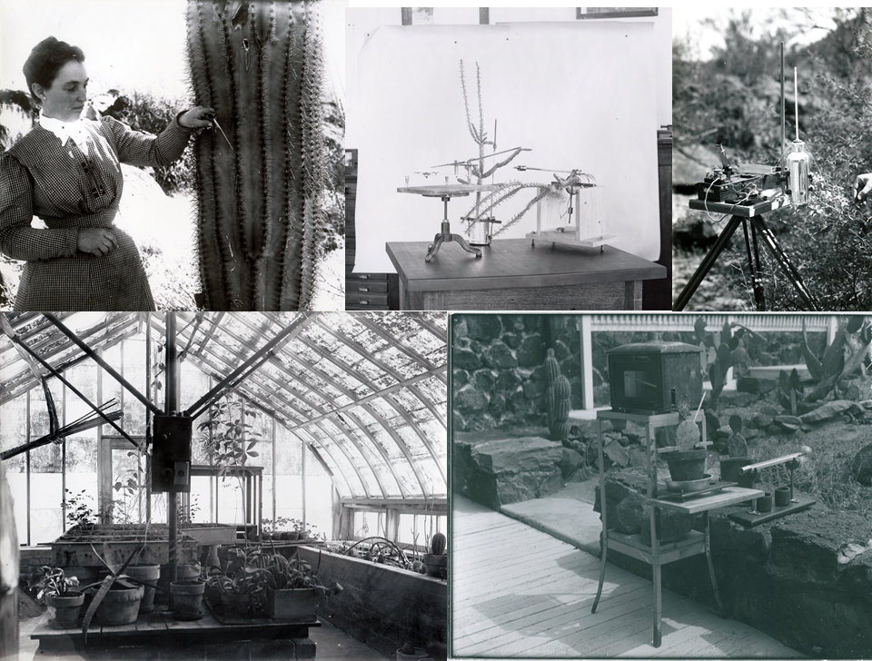
Effie Spalding

Slide 20
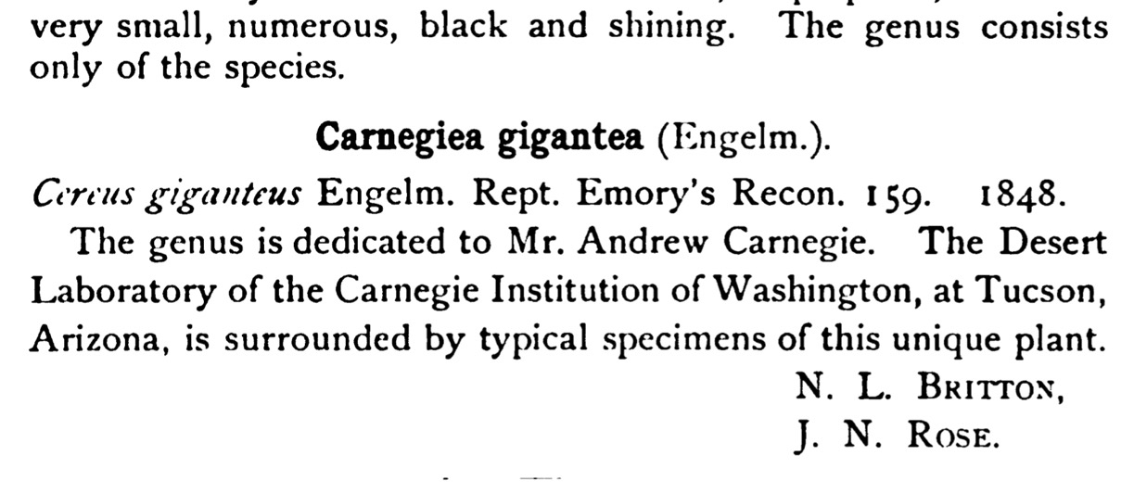

Slide 23
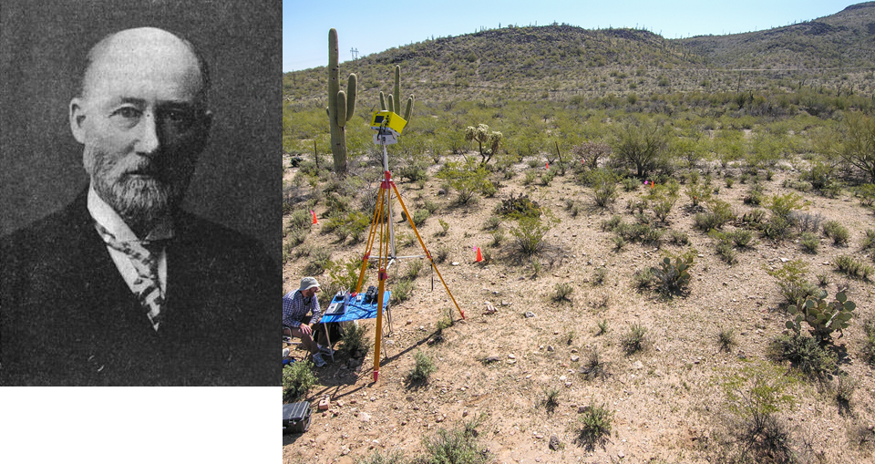
Volney Spalding

Slide 24
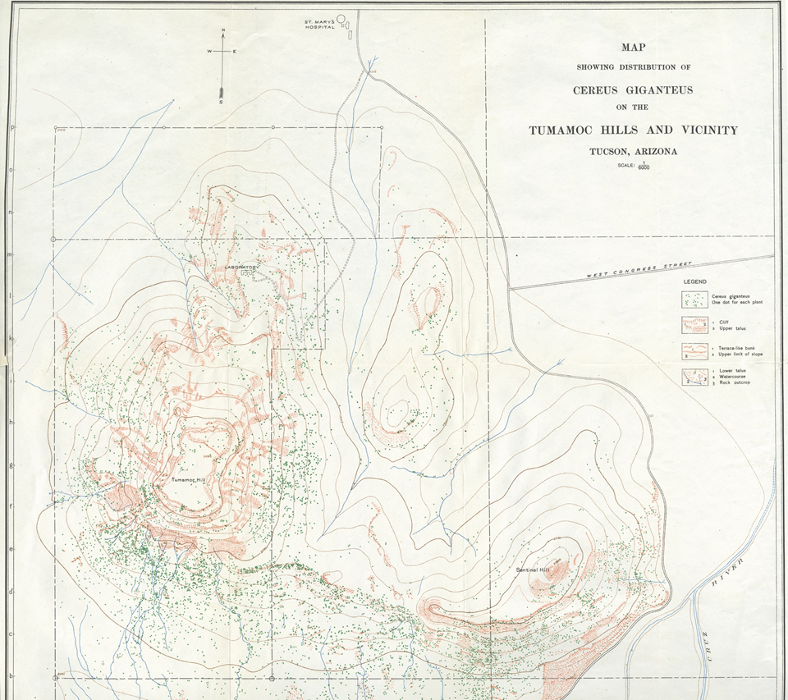

1908: Volney Spalding
Saguaro Plots
1964 – Ray Turner and J.R. Hastings re-establish Spalding’s Saguaro study

Slide 25
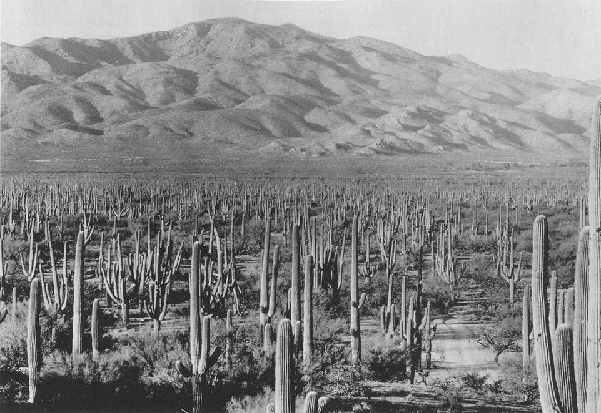
1935

Slide 26
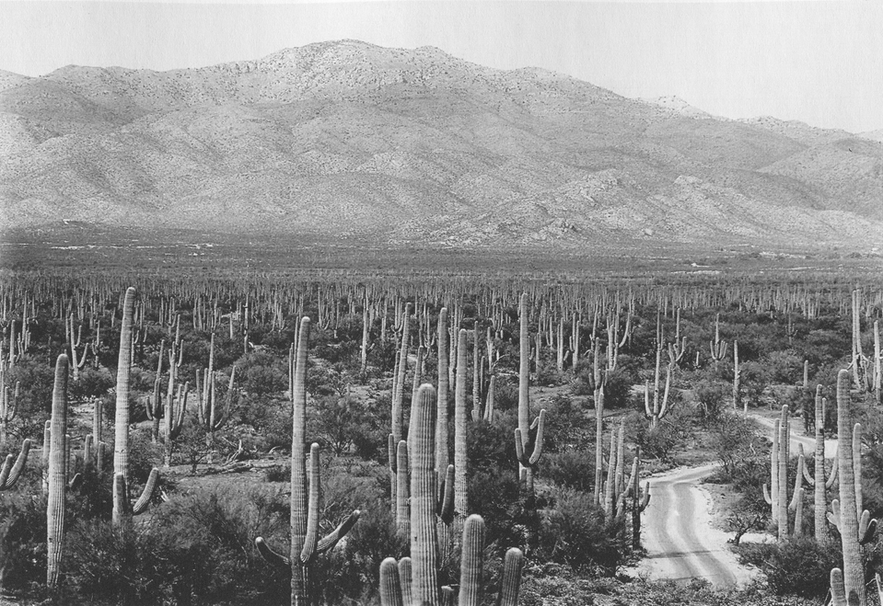
1960

Slide 27
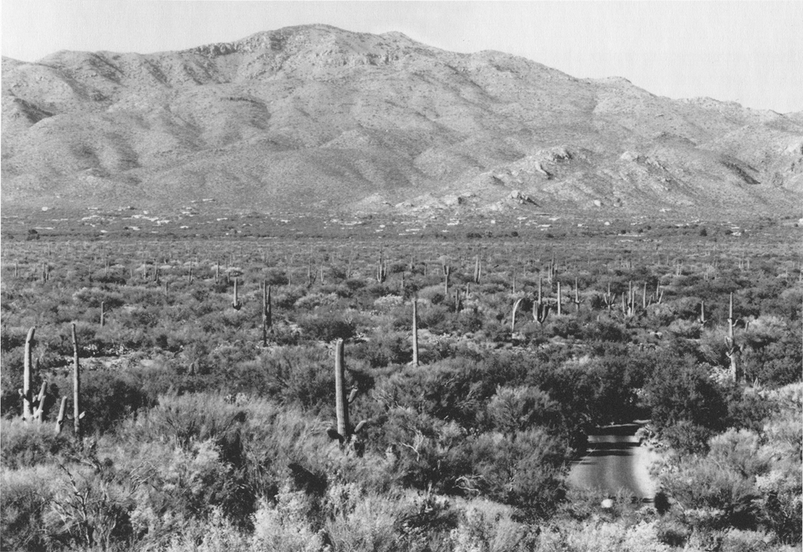
1998

