Slide 1
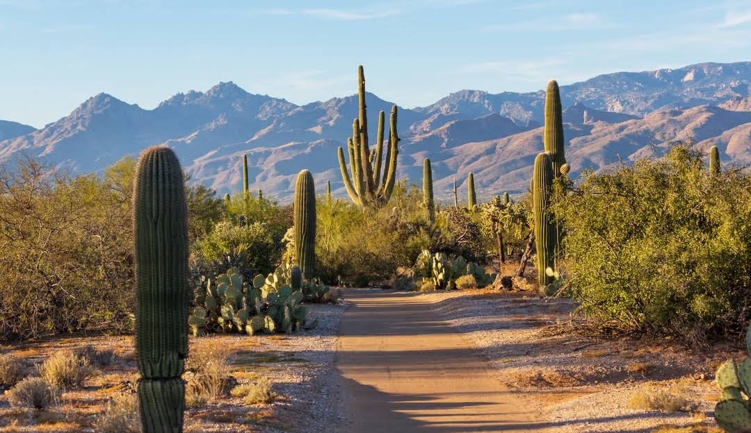

Slide 2
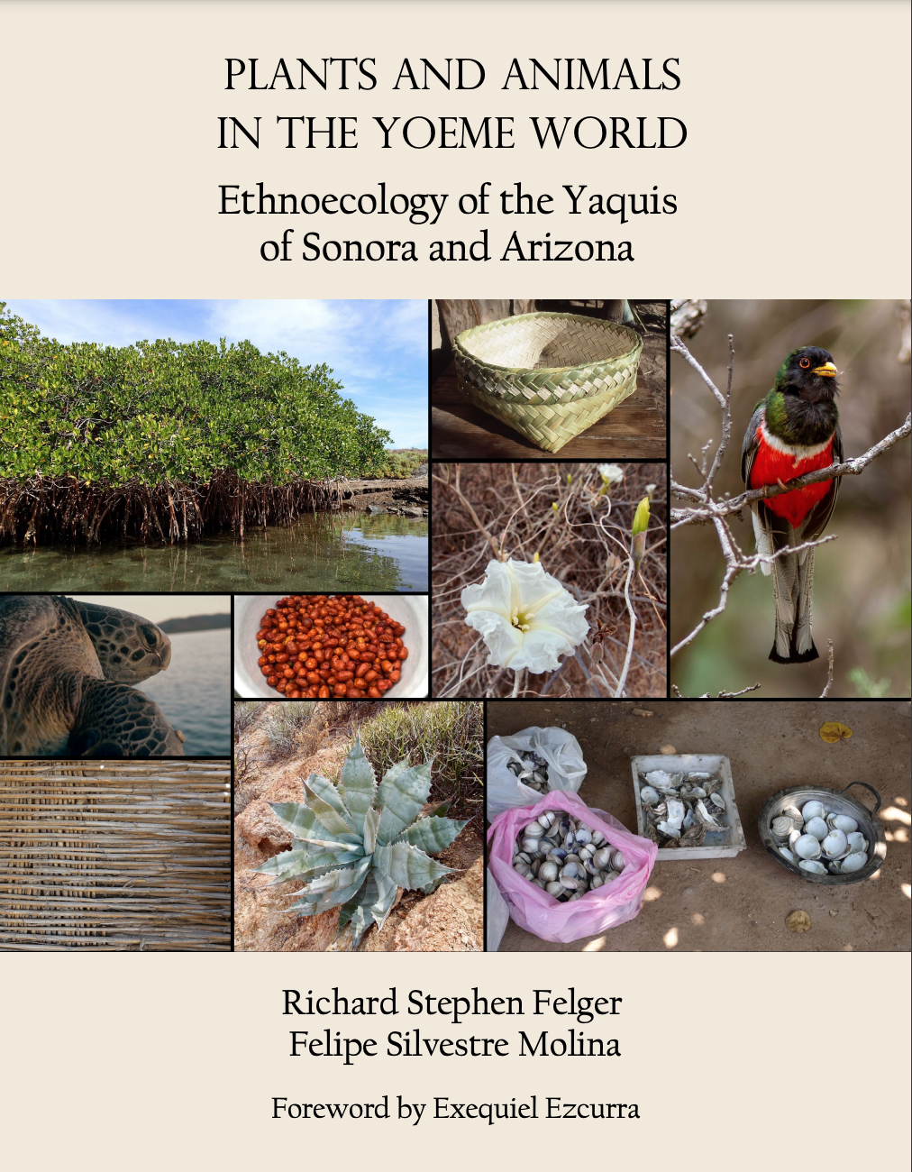


Slide 3
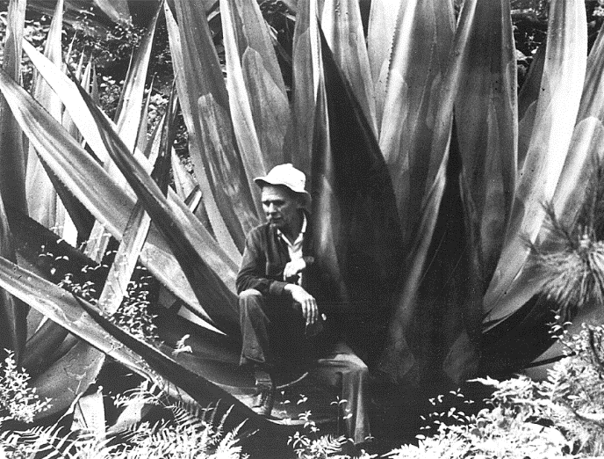
Howard S. Gentry – “Mutualism by two disparate organisms”
“In no other compact a form can one find so many elements of human comfort and civilization!”
“Man nurtured agave and agave nurtured man”
Bicentennial Convention of the CSSA in San Diego, 1975, published in the Saguaroland Bulletin 29(7): 80-84.

Slide 4
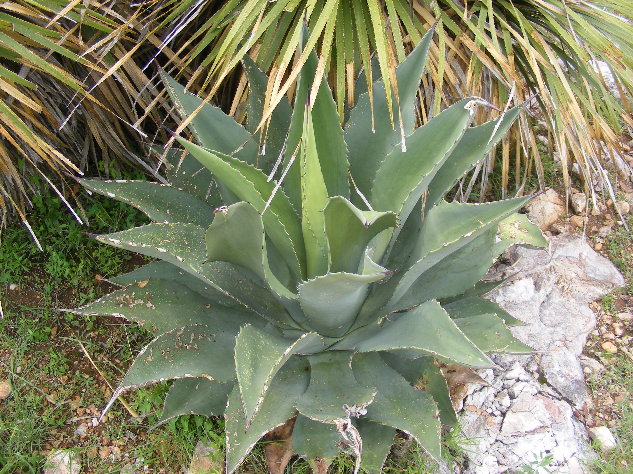
Agave wocomahi

Slide 5
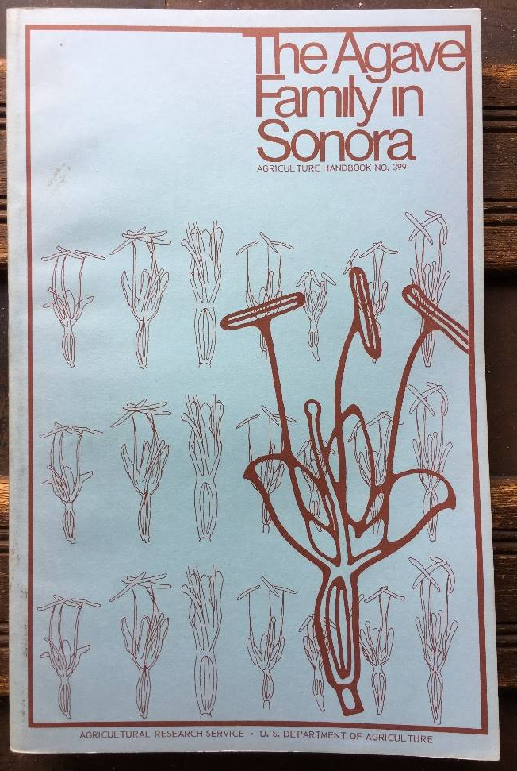
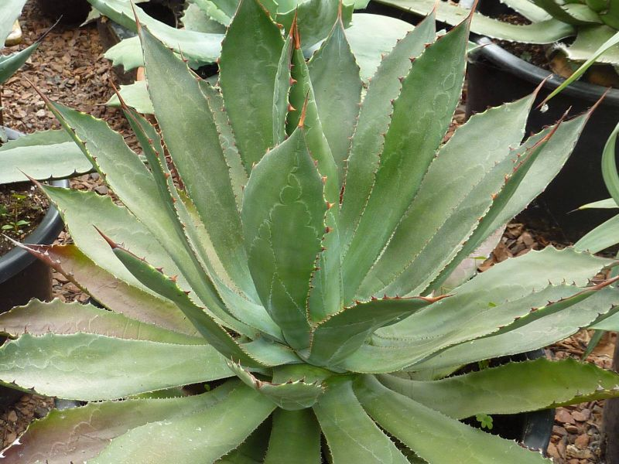
Agave jaiboli

Slide 6
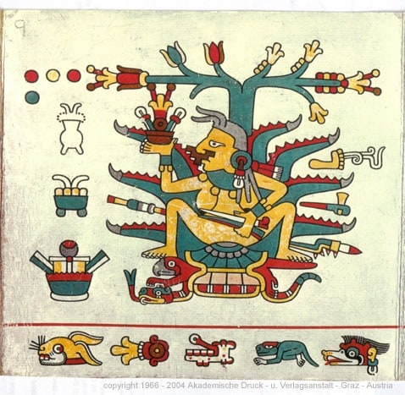
Agave Mezcal, maguey, O’odham: A-úd Yaqui (Yoeme): Kuu’u century-plant
Mayahuel

Slide 7
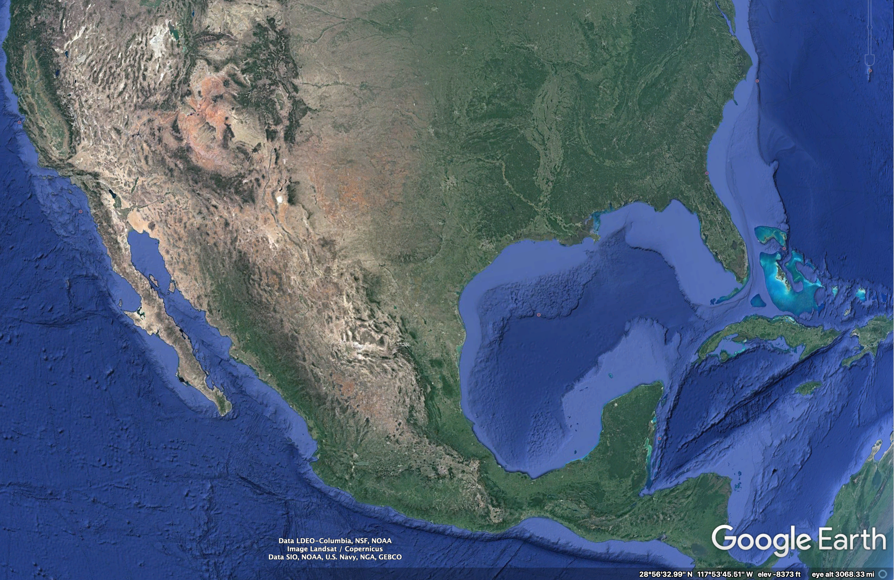
Asparagaceae, Agavoideae
Ca 250 taxa – sw US, Florida, Latin America S to Paraguay, and Caribbean islands
Greatest diversity - central Mexico, center of origin, where 61% endemic
(Garcia-Mendoza 1998; García-Mendoza et al 2019;
Tambutti 2002)

Slide 8
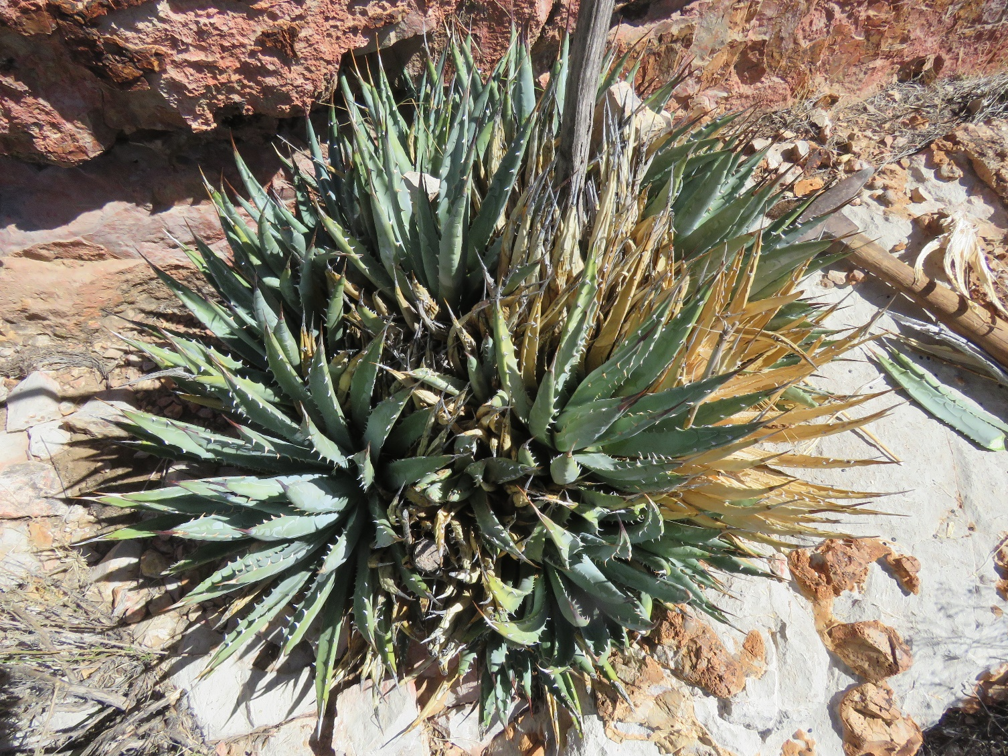
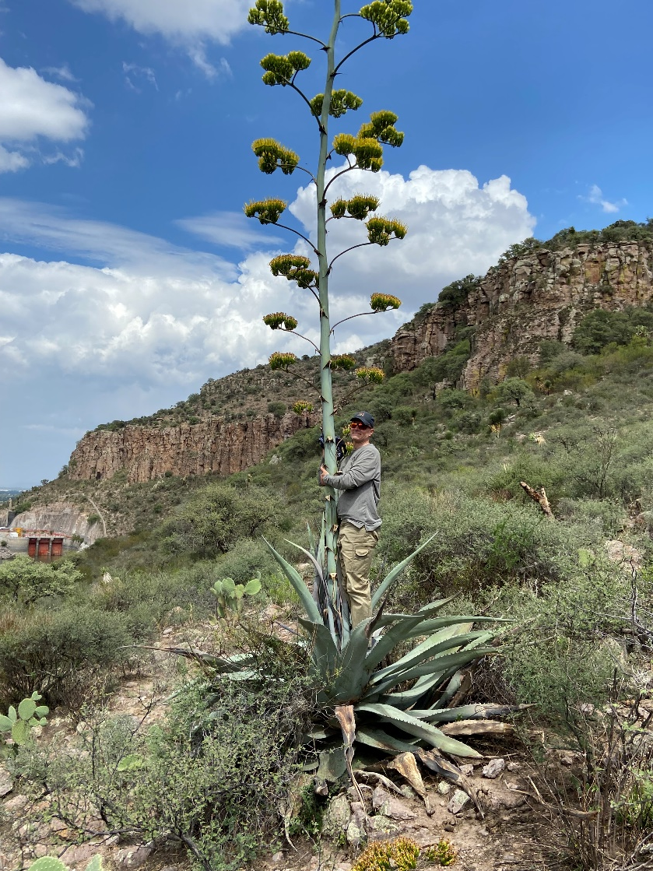
Agave Adaptive Traits – Rosette size decreases with increased aridity
Durango, Mexico
Northeast Arizona

Slide 9
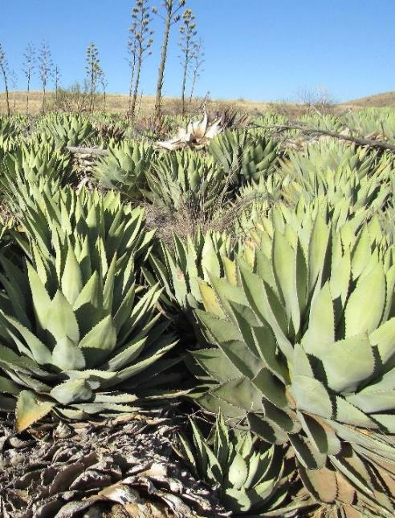
Agave possibly originating ca 10+ million years ago
Expanded into arid and semi-arid regions
Important ecological roles in ecosystems, including arid regions
(Good-Avila et al., 2006; Liedias et al. 2020)

Slide 10
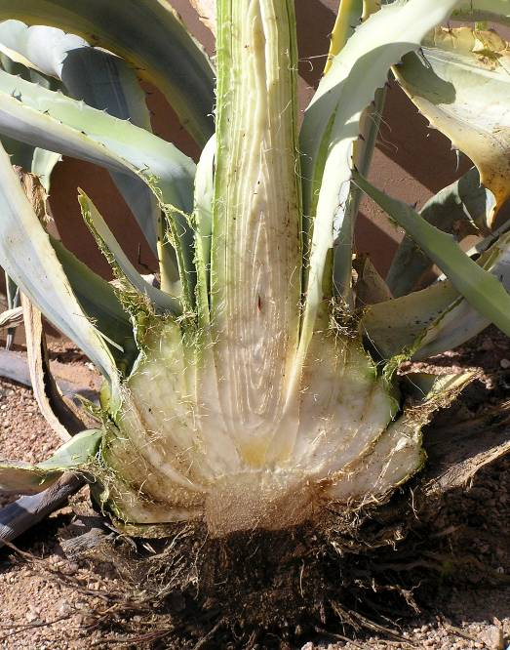
Agaves
Apical meristem
Most Agave are “monocarpic” or “multi-annual” – produces its flower stalk from the apical meristem, or apical growing point
Rosette dies after flowering with few exceptions
Leaf bases
Roots

Slide 11
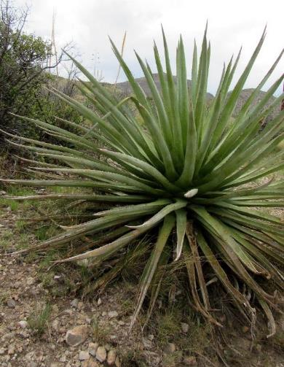
Agave traits to survive in arid regions
Rosettes at or near soil surface
Shallow roots
Vegetative reproduction – “pupping”
Leaf and stem succulence
Thick cuticles
CAM photosynthesis
Burgess 1985; Nobel 1988; Martorell and Ezcurra 2007; Luján et al. 2009)

Slide 12
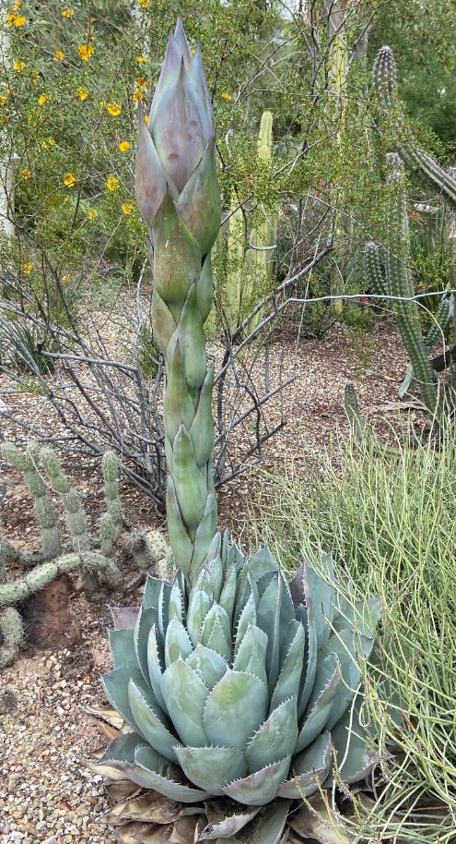
Adapatations – Fructans: prebiotic molecules
Agavins – a fructan, the main carbohydrate stored
Protects against dehydration from drought or freezing
Holscher et al. 2015

Slide 13
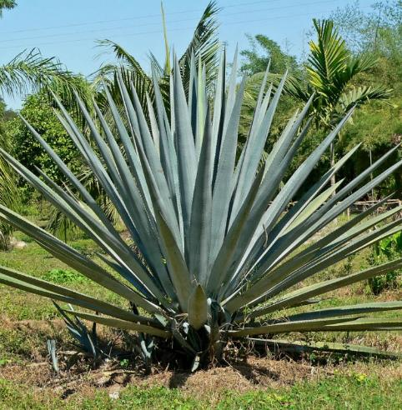
Other Adapatations
Heat Shock Proteins (HSPs)
Provide heat resistance
Increase drought and salt tolerance and pathogen resistance
“Mayahuelin,” after the famous female Agave Goddess, Mayáhuel
(Lledias et al. Frontiers in Plant Sci. 2020)
Agave tequilana var. azul

Slide 14
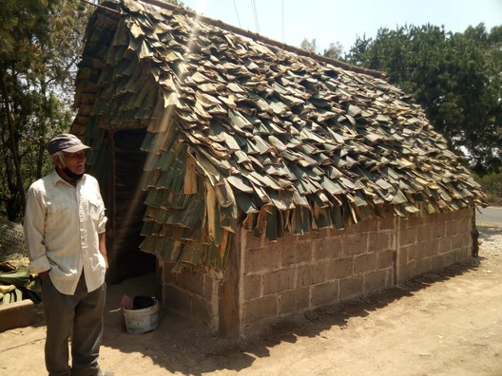
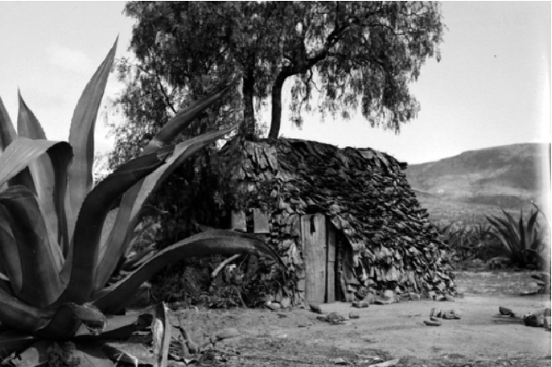
Fiber and Construction

Slide 15
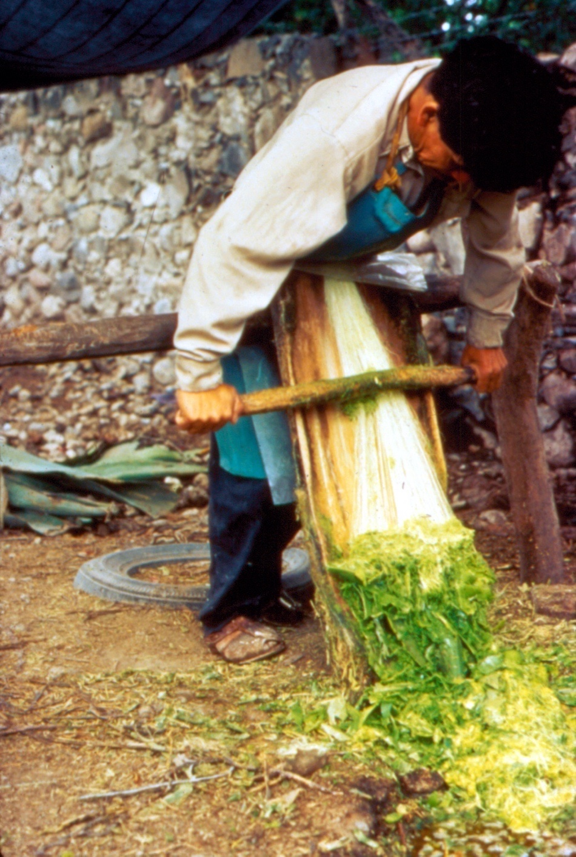
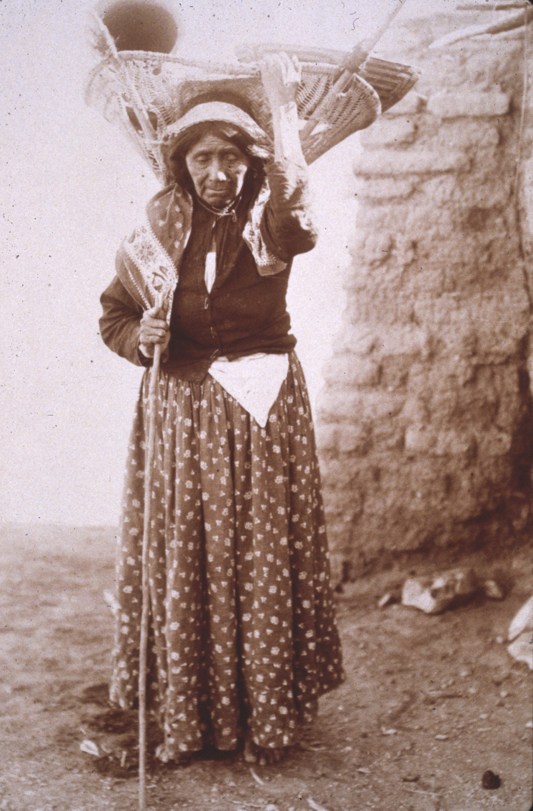
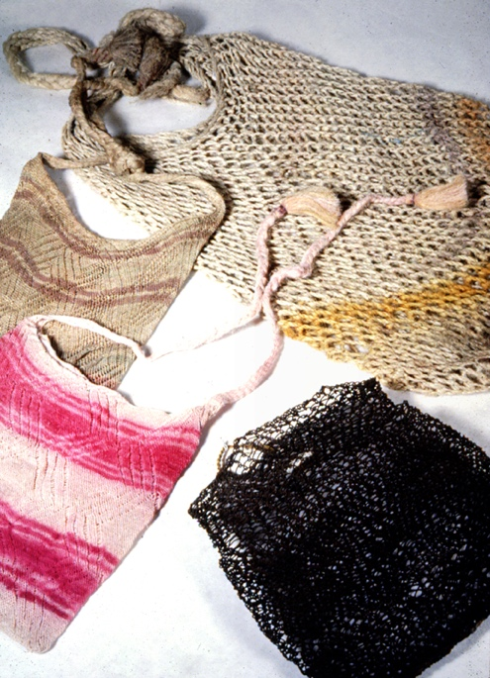
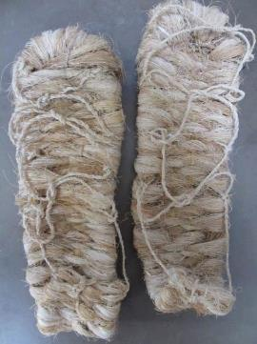
Fiber Extraction
Thread for Twine,
Rope, and Textiles
O’odham Womens’
Carrying Basket
Net Bags
Sandals

Slide 16
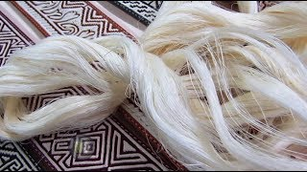
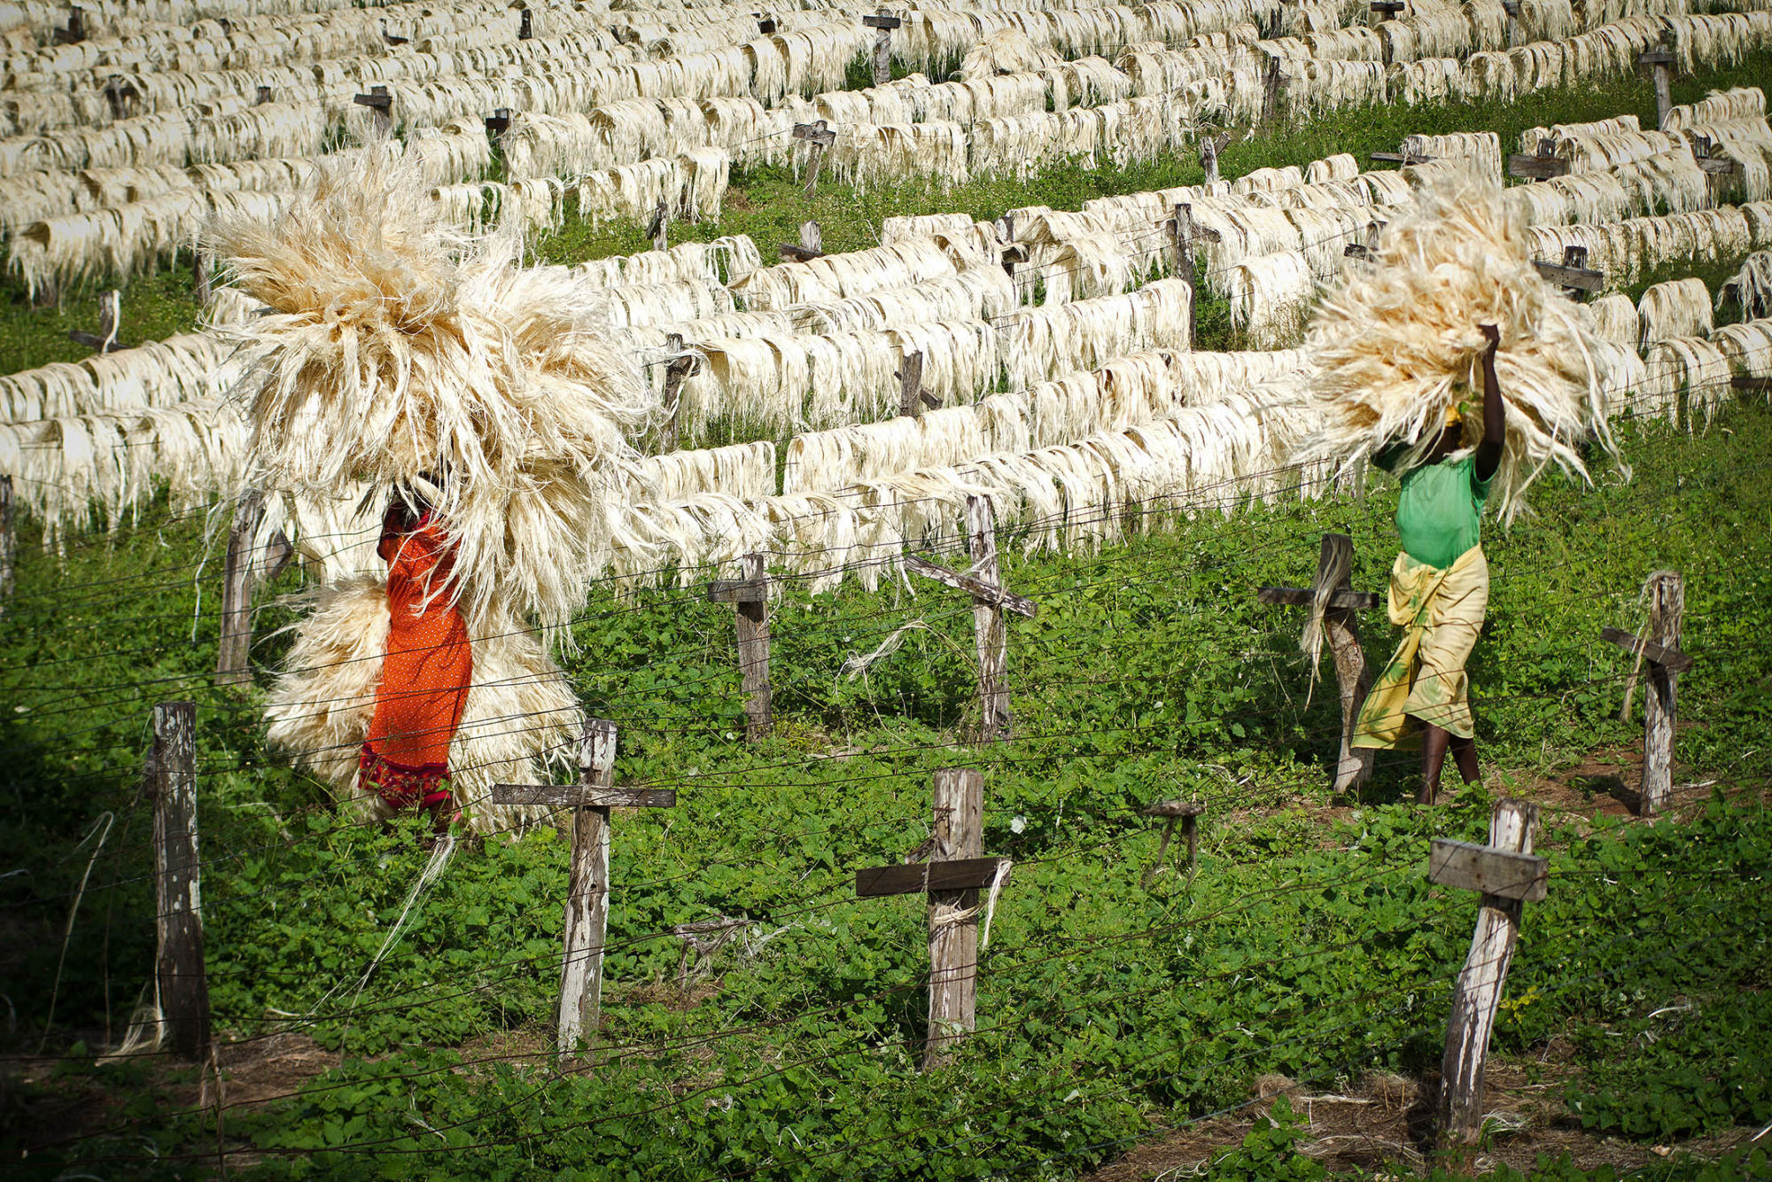
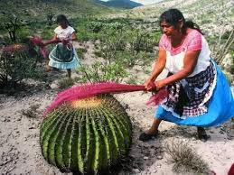
Sisal/Ixtle/Pita

Slide 17
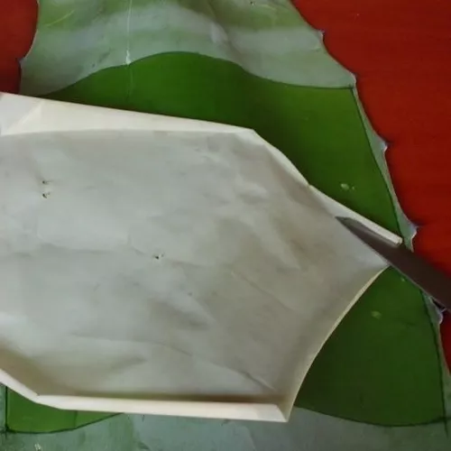
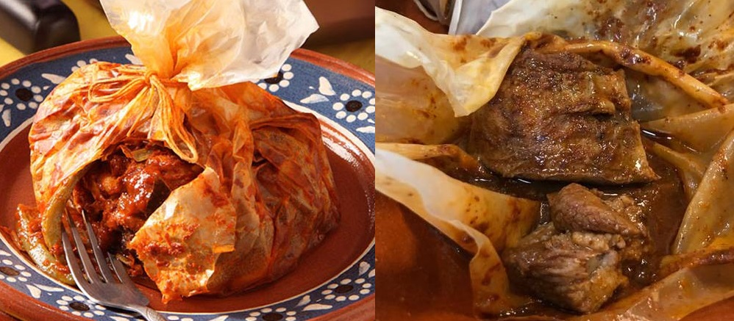
Mixiote

Slide 18
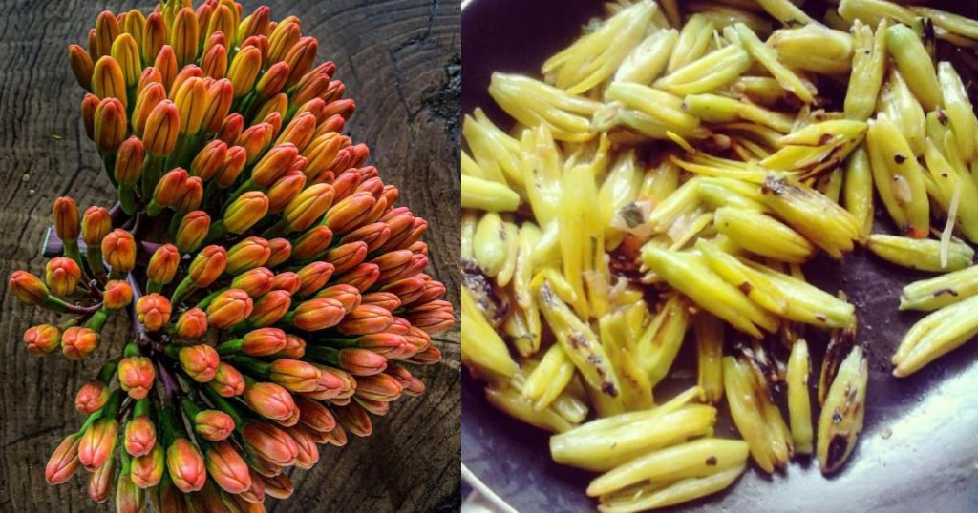
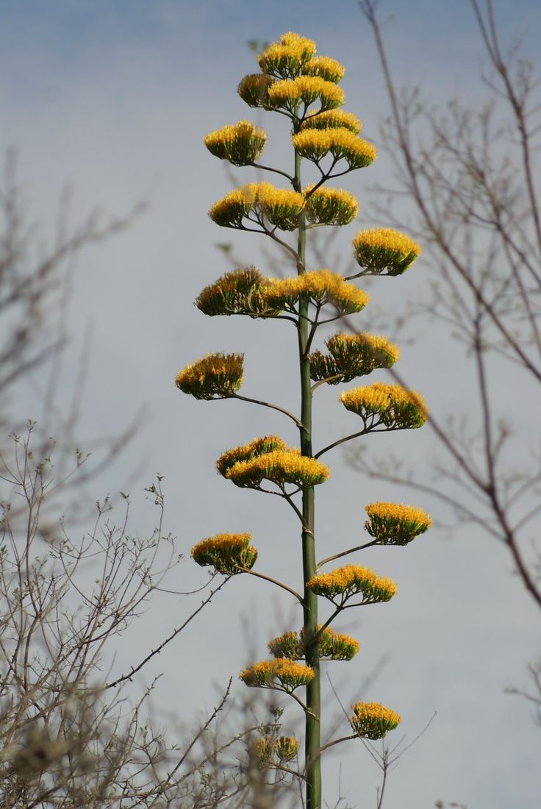
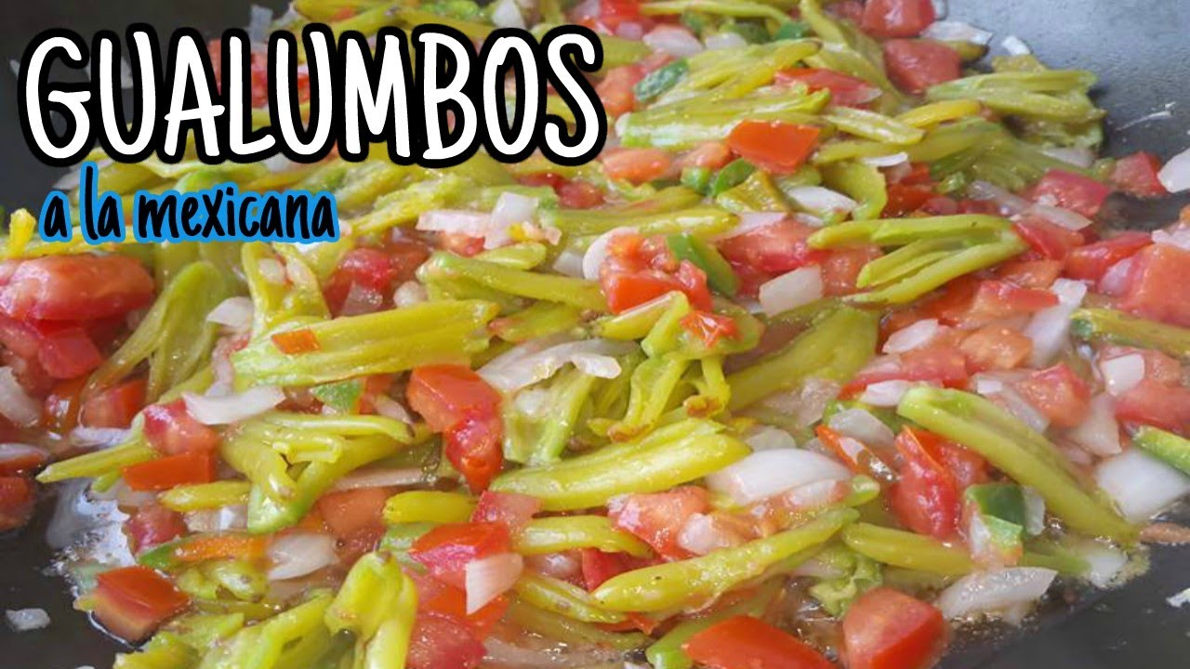
Vallusas/Bayusas

Slide 19
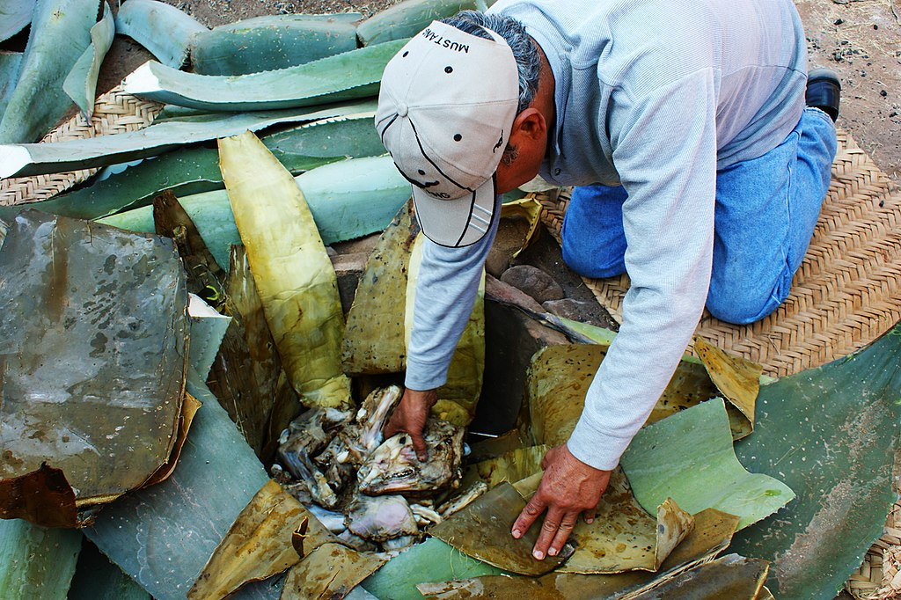
Food

Slide 20
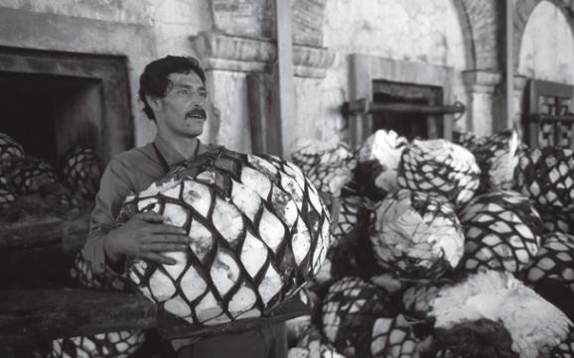
18 agave species cultivated in Mexico not known from the wild
Cultivation persisting for centuries

Slide 21
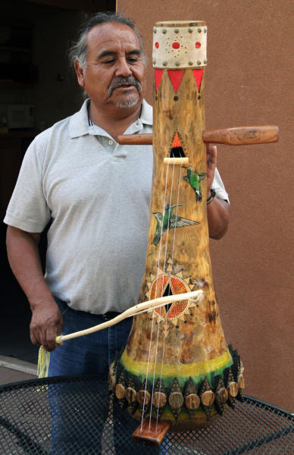
Many Other Values/Uses in Arid America
Ceremonial
Medicine
Soap
Blankets
Musical Instruments
Quivers, vessels, tattoos, bow lines, tumplines, arrow quivers, fuel starters, and many more!
70+ uses/values!
Castetter et al. 1938; García-Mendoza 1998; Carrie Cannon, 2020
San Carlos Apache artist Anthony Belvado, School for Advanced Research
https://sarweb.org/

Slide 22
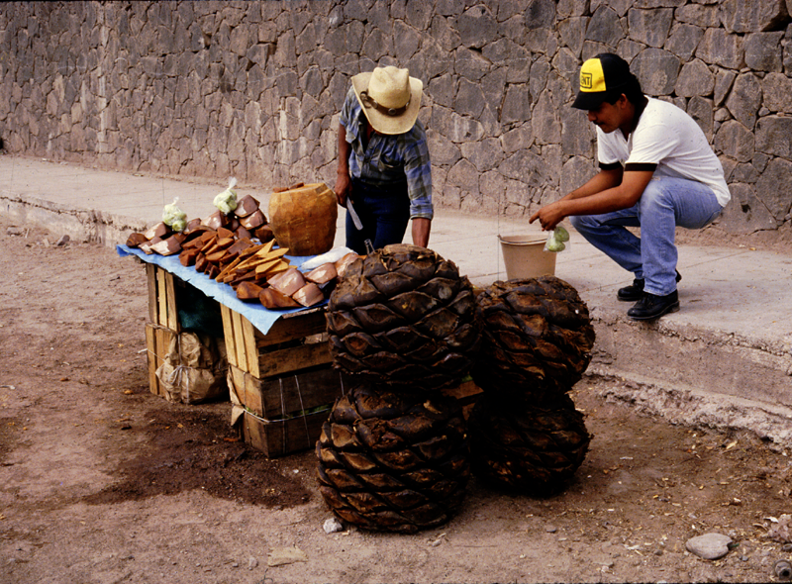
Agave for Food and
Alcoholic Beverages
Baked Agave Hearts Sold as Sweets
in Guaymas, Sonora
Agave Syrup Made from Baked Heart
Fermented Agave Beverages Related to Continuum of Mesoamerican Ritual Practices
H. J. Bruman (2000)
Alcohol in Ancient Mexico, p. 13
Apache Woman Preparing Dried Agave for Storage (ASM Neg. 18208)

Slide 23
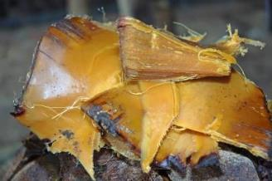
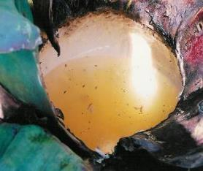
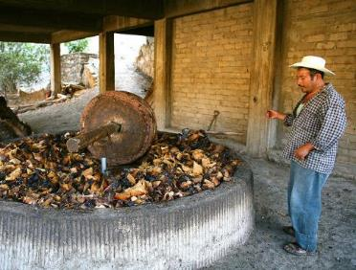
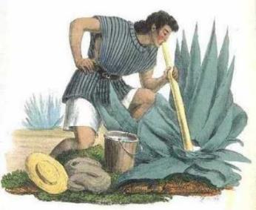
Wine/tiswín/tepache
Pulque
Agave
Mezcal
Tequila
Mezcal
Bacanora
Raicilla
Tobalá, and others
Notes:
Ceremonial
medicinal

Slide 24
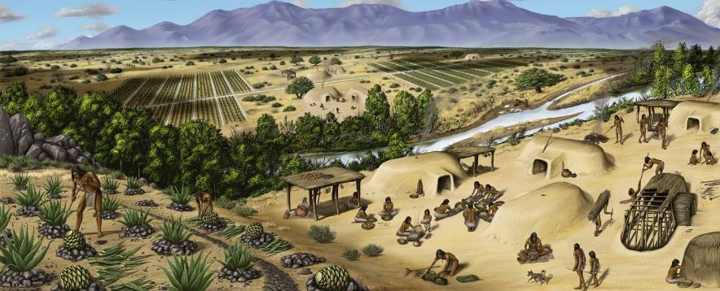
“The ease … humans can cultivate and transport agaves with rhizomatous offsets would enable ancient farmers to quickly select and perpetuate agave genetic variants” (Gentry 1982)
Scott Seibel, Seibel Studios, http://www.seibelstudio.com/blog/?p=104

Slide 25
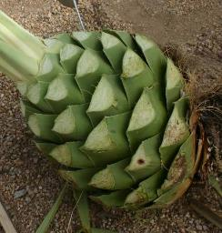
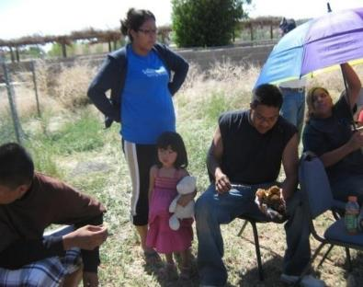
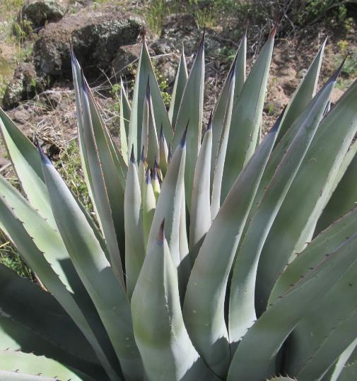
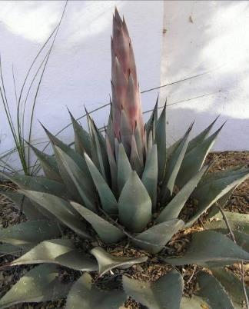

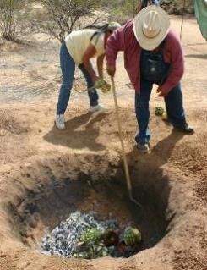
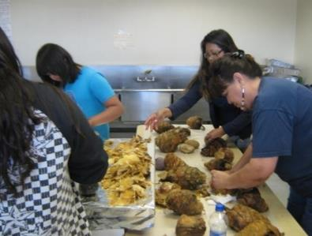
Food – Used for 9,000 – 10,000 years!
Photos courtesy of Carrie Cannon

Slide 26
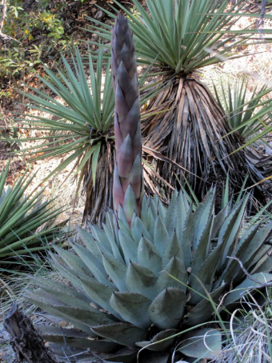
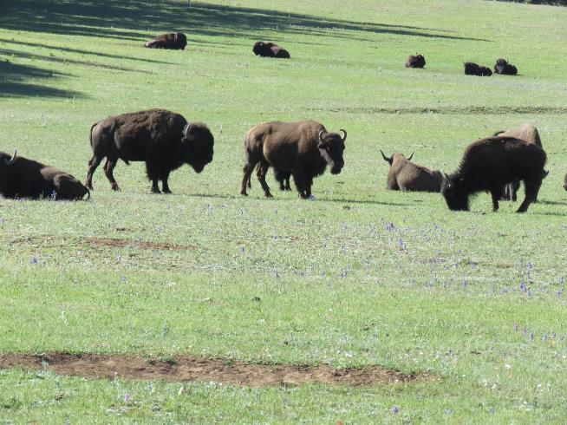
The “buffalo of the region”
Archaeobotanist Phil Dering

Slide 27
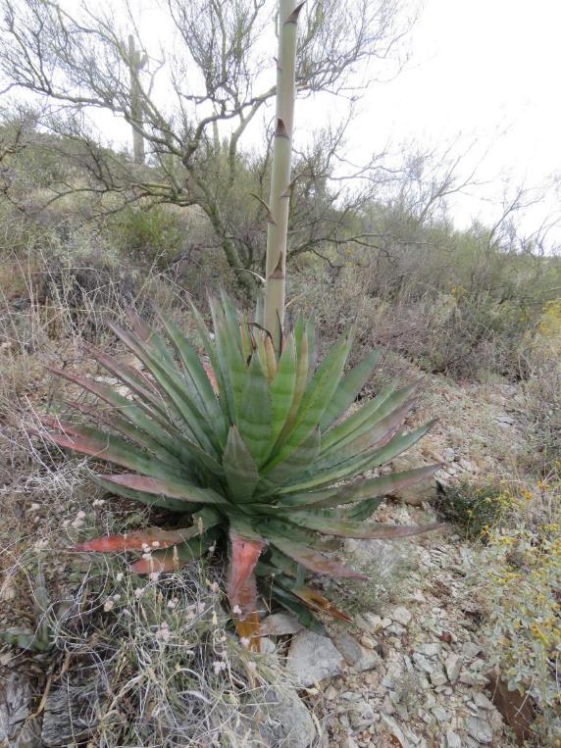
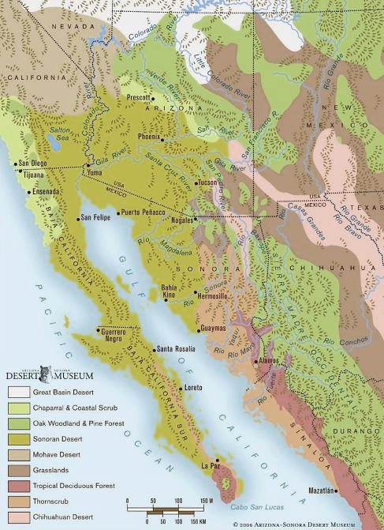
Agaves in Sonoran Desert
Important to all groups who accessed plants through harvesting and trade
Nutritious food
Calcium, dietary fiber, fructans
Good source of iron, potassium, calories
Agave murpheyi
A. utahensis, A. parryi
A. mckelveyana
A deserti
A. simplex
A. chrysantha,
A. parryi,
palmeri,
A. deserti,
A. moranii
A. simplex, A. palmeri, A. shrevei,
A. parryi, A. zebra, A. pelona,
A. fortiflora, A. colorata, A. cerulata,
A. chrysoglossa
A. cerulata
A. shawii
A. cerulata
A. subsimplex, A. angustifolia
A. sebastiana
A. vizcainoensis,
A. cerulata
A. gigantensis,
A. sobria
A. sobria
Base map
Arizona-Sonora
Desert Museum
A. capensis, A. promontory,
A. sobria

Slide 28
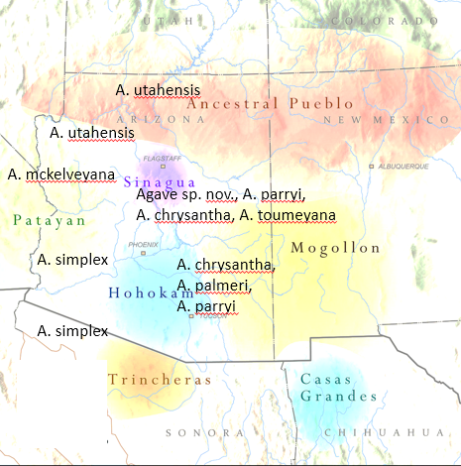
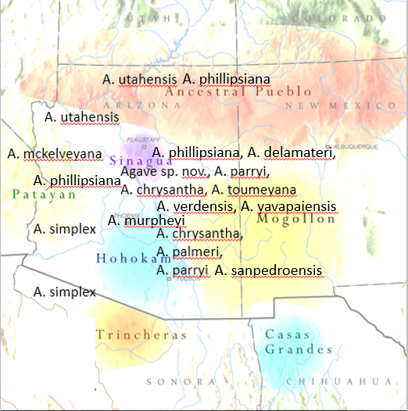
Arizona Edible Agaves:
Non-domesticated
Wild and pre-contact domesticated
Notes:
28
Not only was agave cultivation extensive, they cultivated a number of different species. These are an important part of our plant diversity.

Slide 29


Close Association with Archaeological
Features That May Include:
Rock piles
Man-made terraces

Slide 30




Field Houses, dwellings, roasting pits
Macroplant material (leaf fragments, spines, teeth); quids, pollen
Fish et al. 1985
Van Buren, Skibo & Sullivan 1992

Slide 31


Agave processing tools - knives, scrapers

Slide 32

Asexual Reproduction

Slide 33

Agave murpheyi Bulbils
25% survivorship of detached bulbils with no water for 3 years
Poor dispersal but good establishment in rock piles
Easily traded and moved

Slide 34


Produce very little or no fertile seed/fruits
Long interaction humans and agaves changes
Marcela Sandoval Velasco, pers. comm.

Slide 35

Relatively uniform morphology, low genetic variability

Slide 36

Traits Selected: Leaves easily cut
Agave phillipsiana

Slide 37

Taste?
Sweetest:
A. verdensis
A. yavapaiensis
A. phillipsiana
Least sweet:
A. chrysantha
A. parryi
Notes:
37

Slide 38

What Other Traits/Characteristics
Could Have Been Selected?
Shorter life cycles (especially with aid of rock mulch features)
Agave murpheyi

Slide 39


Ability to Handle Heat and Drought
Agave murpheyi
2020
2023

Slide 40



Agave Is Life
Edward Curtis, 1907,
Smithsonian Institution
Photos courtesy of Carrie Cannon

Slide 41




First Nations Linguistics and Ethnobotany Programs
Photos courtesy of Carrie Cannon

Slide 42



Continuing a Tradition – Agave Roasts
Carrie Cannon, photos

Slide 43


Carrie Cannon, Cultural Resources, Peach Springs,
Vincent Diaz, Tribal Affairs Assistant, GRCA, DBG and Agave phillipsiana

Slide 44

Hualapai Ethnobotany Program
Courtesy, Hualapai Cultural Center
“The issue of climate change and biodiversity cannot be resolved without the real and effective participation of Indigenous Peoples.”
Dario Mejia Montalvo, 22nd United Nations Forum on Indigenous Issues, April 2023

Slide 45
Agave is Life
There are as many ways of seeing as there are things to see.
Nobody can see all of it.
We all just get a piece of the puzzle.

